Slide 1
Trauma and Stressor Related Disorders: Posttraumatic Stress Disorder and Acute Stress Disorder
By: Kourtney Gorham University of Regina

Slide 2
Presentation Overview
Trauma- and Stressor-Related Disorders Overview
DSM-5 Criteria/Specifiers for Posttraumatic Stress Disorder (PTSD)
PTSD Overview
DSM-5 Criteria for Acute Stress Disorder
Acute Stress Disorder Overview
Diagnostic Assessment and Interview Questions
Evidence-Based Treatments
Notes:
We will look at diagnostic and associated features, prevalence, developmental course, etiology, culture- and gender-related diagnostic issues, functional consequences, differential diagnosis, and comorbidity.

Slide 3
Trauma- and Stressor-Related Disorders Overview
Traumatic Events: exposure to actual or threatened harm or fear of death or injury, and include a wide range of careless, intentional acts and unintentional circumstances.
Stressful Events: typically more common and less extreme than traumatic events but can still play a significant role in adjustment and well-being.
Child Maltreatment: considered one of the worst and most intrusive forms of trauma and stress, including physical abuse, neglect, sexual abuse, and psychological abuse.
(Mash & Wolfe, 2019, p. 403)
Notes:
Intentional - abuse, neglect; Unintentional - medical traumas, acts of nature
Stressful events fall within the normal range, such as changing schools, moving, minor peer conflicts, test-taking, etc. These events do not exceed the child’s coping ability or the ability of those around the child to support with coping (Mash et al., 2019, p. 423).

Slide 4
Trauma- and Stressor-Related Disorders Overview
Brainstorm potential traumatic events with your partner.
Notes:
Events: kidnapping, war crimes, threatened/actual physical/sexual assault, robbery, mugging, childhood abuse, sex trafficking, terrorist attacks, torture, incarceration as a prisoner of war, natural or human-made disasters, sever motor vehicle accidents, sex without consent or not developmentally appropriate in children, medical incidents like waking during surgery, domestic violence, death not by natural consequences ex. Suicide, assault, serious accident/injury, etc.

Slide 5
Trauma does not discriminate: “in North America, before they reach adulthood, 1 in 4 girls and 1 in 20 boys experience sexual abuse or assault by an adult or peer... [and] each year about 1 in 10 children receives physical punishment by a parent or other caregiver harsh enough to put the child at risk of injury or harm. Each day in the United States more than 4 children - most of whom are under 4 years old - die at hands of their parents or caregivers.”
(Mash & Wolfe, 2019, p. 404).
Notes:
Trauma occurs across cultures, countries, ages, and genders.
Over 15 million American children have families with partner violence in the home that year.
And trauma costs $124 billion per year in U.S.
In Canada, there have been no comprehensive studies on the cost of trauma. However, Wilson et al. (2016) note that it is “estimated that productivity losses alone due to mental illness cost the Canadian economy $20.7 billion annually.”

Slide 6
Posttraumatic Stress Disorder (PTSD) Video by Osmosis
Notes:
PTSD: https://www.youtube.com/watch?v=hzSx4rMyVjI
DSM 3 - 1980

Slide 7
DSM-5 Criterion A: Posttraumatic Stress Disorder
Criterion A: Exposure to actual or threatened death, serious injury, or sexual violence in one (or more) of the following ways:
Directly experiencing the traumatic event(s).
Witnessing, in person, the event(s) as it occurred to others. Note: In ages 6 and under, focus is on primary caregivers and does not include events only witnessed electronically.
Learning that the traumatic event(s) occurred to a close family member or friend. In cases of actual or threatened death of a family member or friend, the event(s) must have been violent or accidental. Note: In ages 6 and under, focus is on primary caregivers.
Experiencing repeated or extreme exposure to aversive details of the traumatic event(s). Note: In ages 6 and older only.
Notes:
4. Examples: first responders, police but not through electronic sources unless it is work-related exposure.

Slide 8
DSM-5 Criterion B: Posttraumatic Stress Disorder
Criterion B: Presence of one (or more) of the following intrusion symptoms associated with the traumatic event(s), beginning after the traumatic event(s) occurred:
Recurrent, involuntary, and intrusive distressing memories of the traumatic event(s). Note: In ages 6 and under, may not appear distressing and may be expressed through play.
Recurrent distressing dreams in which the content and/or affect of the dream are related to the traumatic event(s). Note: In ages 6 and under, it may not be possible to ascertain that the frightening content is related to the traumatic events.
Dissociative reactions (e.g., flashbacks) in which the individual feels or acts as if the traumatic event(s) were recurring.
Intense or prolonged psychological distress at exposure to internal or external cues that symbolize or resemble an aspect of the traumatic event(s).
Marked physiological reactions to internal or external cues that symbolize or resemble an aspect of the traumatic event(s).
Notes:
Children - repetitive play/drawings/stories with themes/aspects of the traumatic events expressed; might not be flashbacks
Children - frightening dreams without recognizable content.
Continuum - most extreme where loss awareness of present surroundings. Children - trauma-specific reenactment in play.
Involuntary - differs from an obsession or depressive thought in that way
Not depressive, rumination because involuntary.
Somatic and sensory senstations triggered. Even if flashback is brief, can have prolonged distressed/hightened afterwards.

Slide 9
DSM-5 Criterion C: PTSD (Ages 6+)
Criterion C: Persistent avoidance of stimuli associated with the traumatic event(s), beginning after the traumatic event(s) occurred, as evidence by one or both of the following:
Avoidance of or efforts to avoid distressing memories, thoughts, or feelings about or closely associated with the traumatic event(s).
Avoidance of or efforts to avoid external reminders (people, places, conversations, activities, objects, situations) that arouse distressing memories, thoughts, or feelings about or closely associated with the traumatic event(s).
Notes:
Almost always or always avoid

Slide 10
DSM-5 Criterion D: PTSD (Ages 6+)
Criterion D: Negative alterations in cognitions and mood associated with the traumatic event(s), beginning or worsening after the traumatic event(s) occurred, as evidence by two (or more) of the following:
Inability to remember an important aspect of the traumatic event(s).
Persistent and exaggerated negative beliefs or expectations about oneself, others, or the world.
Persistent, distorted cognitions about the cause or consequences of the traumatic event(s) that lead the individual to blame themselves or others.
Persistent negative emotional state.
Markedly diminished interest or participation in significant activities.
Feelings of detachment or estrangement from others.
Persistent inability to experience positive emotions.
Notes:
Typically due to dissociative amnesia and not to other factors like a head injury or substances/abuse.
“I am bad. I will never be okay again.” “The world is completely dangerous and no one can be trusted.” “It’s all my fault.”
4. Fear, horror, anger, guilt, shame
7. Happiness, satisfaction, love

Slide 11
DSM-5 Criterion C: PTSD (Ages 6 and Under)
Criterion C: One (or more) of the following symptoms, representing either persistent avoidance of stimuli associated with the traumatic event(s) or negative alterations in cognitions and mood associated with the traumatic event(s), must be present, beginning after the event(s) or worsening after the event(s):
Persistent Avoidance of Stimuli
Avoidance of or efforts to avoid activities, places, or physical reminders that arouse recollections of the traumatic event(s).
Avoidance of or efforts to avoid people, conversations, or interpersonal situations that arouse recollections of the traumatic event(s).
Negative Alterations in Cognitions
Substantially increased frequency of negative emotional states.
Markedly diminished interest or participation in significant activities, including construction of play.
Socially withdrawn behavior.
Persistent reduction in expression of positive emotions.
Notes:
3. Fear, guilt, sadness, shame, confusion

Slide 12
DSM-5 Criterion E: Posttraumatic Stress Disorder
Criterion E: Marked alterations in arousal and reactivity associated with the traumatic event(s), beginning or worsening after the traumatic event(s) occurred, as evidence by two (or more) of the following:
Irritable behavior and angry outbursts (with little or no provocation) typically expressed as verbal or physical aggression towards people or objects. Note: In ages 6 and under, includes extreme temper tantrums.
Reckless or self-destructive behavior. Note: In ages 6 and older only.
Hypervigilance.
Exaggerated startle response.
Problems with concentration.
Sleep disturbances.
Note: This is labelled as Criterion D in ages 6 and under.
Notes:
2. Drunk driving, alcohol use, injurious/suicidality behavior
4. Jumpiness to loud/unexpected noises and movements
5. Both task focus and completion, as well as remembering daily tasks
6. Falling/staying asleep or restlessness

Slide 13
DSM-5 Criterion F-H: Posttraumatic Stress Disorder
Criterion F: Duration of the disturbance (Criteria B, C, D, and E) is more than 1 month.
Criterion G: The disturbance causes clinically significant distress or impairment in social, occupation, or other important areas of functioning. Note: In ages 6 and under, the focus is on distress and impairment in relationships with parents, siblings, peers, or other caregivers or with school behavior.
Criterion H: The disturbance is not attributable to the physiological effects of a substance or another medical condition.
Note: This is labelled as Criterion E-G in ages 6 and under.
Notes:
H. - medications, alcohol, brain injury, seizures

Slide 14
DSM-5 Specifiers: Posttraumatic Stress Disorder
With dissociative symptoms: The individual’s symptoms meet the criteria for PTSD, and in addition, in response to the stressor, the individual experiences persistent or recurrent symptoms of either of the following (not attributed to a medical condition or substance):
Depersonalization: Persistent or recurrent experiences of feeling detached from, and as if one were an outside observer of, one’s mental processes or body.
Derealization: Persistent or recurrent experiences of unreality of surroundings.
With delayed expression: If the full diagnostic criteria are not met until at least 6 months after the event (although the onset and expression of some symptoms may be immediate).
Notes:
Feeling like they were in a dream; unreality of self or body or of time moving slowly
World is experienced as unreal, dreamlike, distant, or distorted.
Dissociative symptoms cannot be attributable to the physiological effects of a substance or another medical condition. Ex. seizures, substance use. Dissociation can lead to BPD, dissociative identity disorder, or chronic pain (Mash et al., 2019, p. 430).

Slide 15
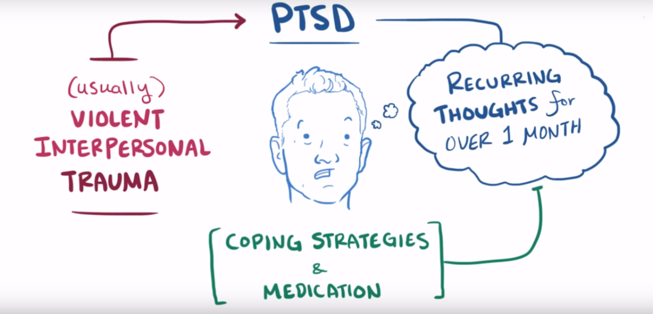
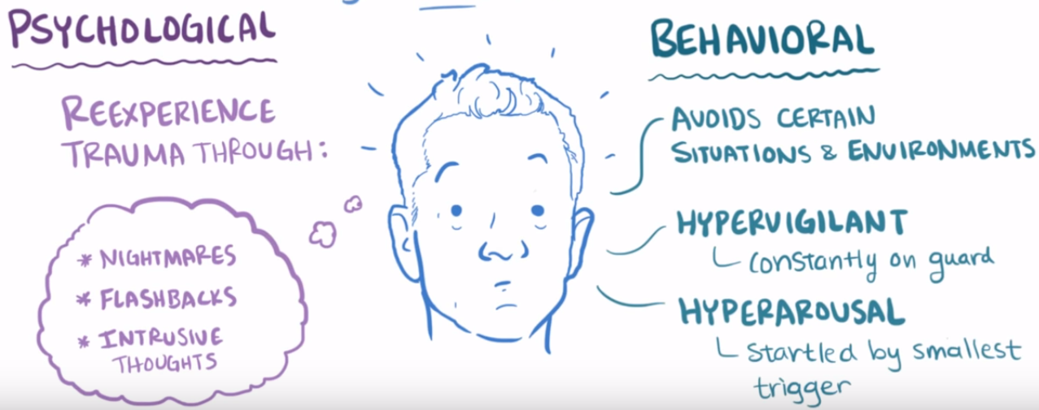
(Osmosis.org)
Notes:
Review

Slide 16
Diagnostic Features: Posttraumatic Stress Disorder
Symptoms occur after or worsen after the traumatic event(s)
The clinical presentation varies: fear-based response, dysphoric mood states, arousal and reactive-externalizing symptoms, dissociative symptoms, or a combined presentation.
Associated Features to Support Diagnosis
Children may experience a developmental regression, such as language loss.
Auditory pseudohallucinations and/or paranoid ideation may occur.
The person may have difficulties with emotional regulation and interpersonal relationships.
Violent death can result in PTSD and problematic bereavement.
(APA, 2013)
Notes:
Criterion D/E in ages 6+ allow for worsening of symptoms
No longer require fear-response in criterion A
Auditory pseudohallucinations - one’s thoughts spoken in one or more voices
Especially with child abuse because prolonged and interpersonal.

Slide 17
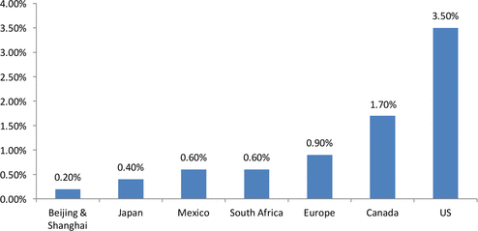
Prevalence: Posttraumatic Stress Disorder
FIGURE 1 One-Year PTSD Prevalency Rates: General Population.
Sources: Kessler, Chui, Demler et al.(2005); Hinton & Lewis (2011); Statistics Canada (2013).
Notes:
Half or more of those with physical, sexual, or both forms of abuse meet criteria for PTSD (Mash et al., 2019, p. 427).
United States: 12 month prevalence for adults is about 3.5%.
European, Asian, African, and Latin American countries: 12 month prevalence for adults is lower at 0.5%-1%.(DSM-5)
Canada: 1.7% (Wilson et. al, 2016).
Rates higher among veterans, those in vocations that lend themselves to traumatic exposure, and survivors of rape, military combat and captivity, and ethnically or politically motivated internment and genocide.

Slide 18
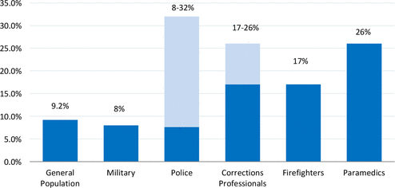
Prevalence: Posttraumatic Stress Disorder
FIGURE 2 Lifetime PTSD Prevalence Rates: Specified Canadian Populations.
Sources: Van Ameringen, Mancini, Paterson et al. (2008); Boulos & Zamorski (2013); Marchand, Boyer, Martin et al. (2010); Asmundson & Stapleton (2008); Rosine (1992); Stadnyk (2004); Corneil, Beaton, Murphy et al. (1999); Regehr, Goldberg & Hughes (2002).
Notes:
Wilson et al. (2016), note that “estimates suggest that as many as 2.5 million adult Canadians and 70,000 Canadian first responders have suffered from PTSD in their lifetimes.”
Social workers/teachers?

Slide 19
Developmental Course: Posttraumatic Stress Disorder
PTSD can occur in ages 1+
Symptoms typically occur within the first 3 months following the trauma but a delayed expression (after 6 months) is possible.
The person may initially meet criteria for an Acute Stress Disorder.
Duration of symptoms varies, with 50% of patients recovering within 3 months. However, symptoms can persist for 12 months or throughout the lifespan.
Symptoms can re-occur due to reminders of or new traumatic experiences.
PTSD may present differently in children and older adults.
(APA, 2013)
Notes:
Delayed expression - some symptoms may have been prior but not full criteria.
Throughout development, less children are found to have PTSD but this may be due to the criteria being insufficiently developmentally informed.
Older adults are more likely to have a subthreshold presentation but still with clinical impairments.(DSM-5)

Slide 20
Developmental Course: Posttraumatic Stress Disorder
Children
Expression through play and storytelling, while their emotional perceptions or identification of onset may be unidentifiable.
May be preoccupied with thoughts/events and behaviors/emotional disturbances are often noted by caregivers.
Adolescents
Adolescents may avoid typical activities, be irritable, aggressive, or have negative moods about self and others.
Risk taking behaviors may occur beyond normal range.
Adults
Older individuals may have negative health perceptions, increased care visits, and suicidal ideation.
In elderly patients, declining health, cognitive functions, and social interaction can worsen symptoms of PTSD
(APA, 2013)
Notes:
Severe, long-lasting, and co-occurring traumas when there was intent and interpersonal impact (e.g., sexual violence, torture, etc.) have a longer developmental course. (DSM-5)
Worse with timing, coercion, severity, proximity to event, and duration.
.

Slide 21
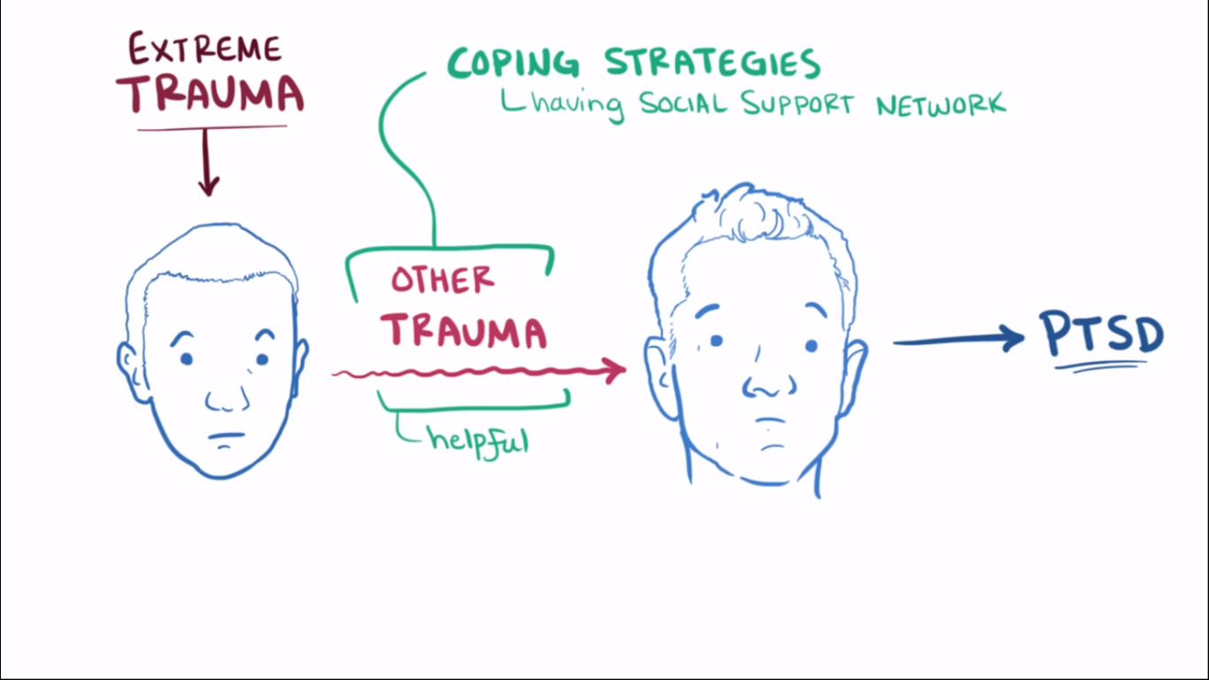
(Osmosis.org)

Slide 22
Functional Consequences: PTSD
Risk of suicide behavior and ideation
Financial and health-based costs
High levels of social, occupation, and physical disability
Poor social and family relationships
Absenteeism from work
Lower income and educational levels
(APA, 2013)

Slide 23
DSM-5 Etiology: Posttraumatic Stress Disorder
Pretraumatic Factors
Temperamental: childhood emotional problems by age 6 years and prior mental disorders.
Environmental: low SES, exposure to prior trauma, childhood adversity, cultural characteristics, lower intelligence, minority racial/ethnic status, and family psychiatric history.
Genetic and physiological: female gender and younger age at time of exposure.
Peritraumatic Factors
Environmental: severity of trauma, perceived life threat, personal injury, interpersonal violence, and dissociation
Posttraumatic Factors
Temperamental: negative appraisals, inappropriate coping strategies, and development of Acute Stress Disorder
Environmental: exposure to reminders, additional adversity, and financial or trauma-related losses.
Notes:
Temperamental: prior traumatic exposure, externalizing/anxiety problems and panic disorder, depressive disorder, PTSD, OCD
Environmental: Economic deprivation, family dysfunction, parental separation or death; fatalistic or self-blaming coping strategies
Social supports are and certain genotypes may be protective factors!
Interestingly, caregivers can be both protective and risk factors. Social supports help in posttraumatic, especially caregiver for child or family stability.
More severe or interpersonal (done by caregiver, etc.) = more likelihood of PTSD
Hyper or hypo responsive to stressful events - allostatic load wear and tear on the biological systems due to stress
Military personal environmental factors include witnessing atrocities, killing an enemy, and perpetrator.
Children - psychological like emotional regulation and view of self and others and neurobiological areas of brain impacted by stress

Slide 24
DSM-5 Etiology: Posttraumatic Stress Disorder
(Osmosis.org)

Slide 25
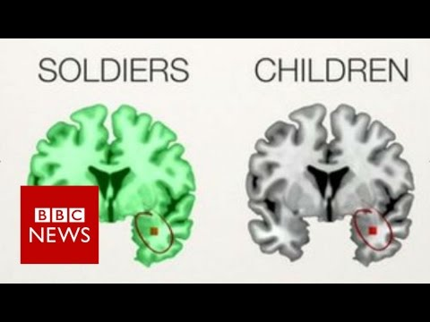
PTSD Brains of Soldiers v.s. Children from BBC News
Notes:
Link: https://www.youtube.com/watch?v=jsxpW55ysk4

Slide 26
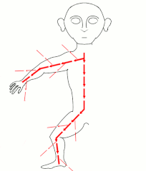
Culture- and Gender-Related Diagnostic Issues
Higher rates found in U.S. Latinos, African Americans, and American Indians
Lower rates in Asian Americans
Varies based on type of traumatic exposure, meaning attributed to it, the ongoing sociocultural context, and other cultural factors like acculturation.
Varies based on expression: avoidance and numbing symptoms, distressing dreams, and somatic symptoms.
More prevalent (including duration) in females than males across the lifespan (about 2x).
(APA, 2013)
Notes:
Variations: genocide, can’t perform funeral rites after mass killing, perpetrators live with or not punished, acculturation stress of immigrants
Varies based on religion/cultural group
Panic attack symptoms may be salient in PTSD among Cambodians and Latin Americans (panic like khyal)
Females greater risk of rape and other forms of interpersonal violence
Women 2x more likely and symptoms last 4x as long but less difference with children (Mash et al., 2019).

Slide 27
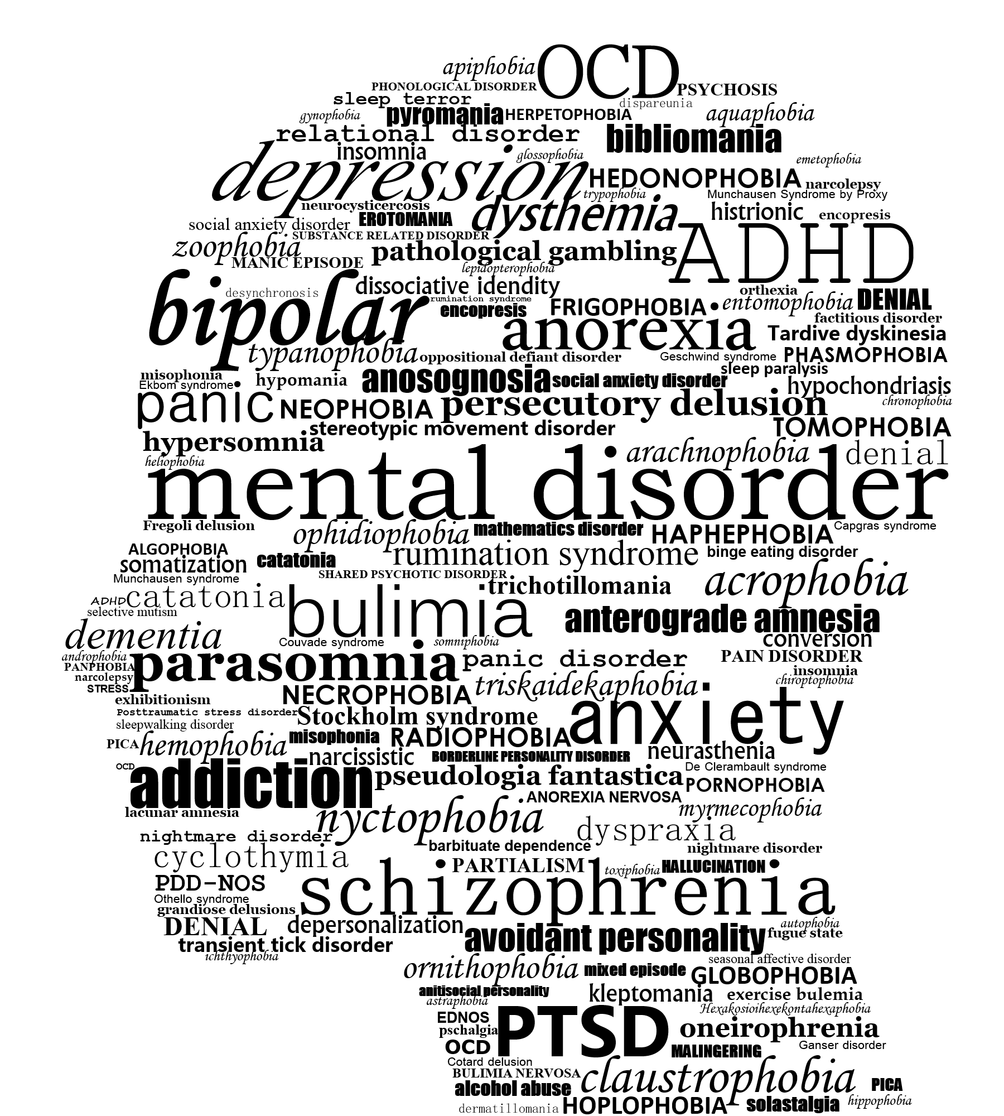
Differential Diagnosis: Posttraumatic Stress Disorder
Adjustment Disorders
Other PTSD
Acute Stress Disorder
Anxiety Disorders and OCD
Major Depressive Disorder
Personality Disorder
Dissociative Disorder
Conversion Disorder
Psychotic Disorders
Traumatic Brain Injury
(APA, 2013)
Notes:
Adjustment disorders - any severity of type rather than what is in criterion A; can give this when PTSD criteria is not met for A (fired, spouse leaves)
Other PTSD - may need dissociative amnesia diagnosis or others
Acute Stress - 3 days to 1 month
Anxiety/OCD - recurring thoughts re obsession and not related to traumatic event; compulsions present; arousal and dissociative symptoms of panic disorder or avoidance, irritability, and anxiety of generalized anxiety disorder are associated with a specific traumatic event; related to separation of home/family and not trauma
MDD - no criteria b and C symptoms and many in D or E
Personality disorders - would not have to do with trauma
Dissociative disorder - subtype
Conversion disorder - new onset of somatic symptoms might be due to trauma rather than conversion disorder
Psychotic disorder - distinguish flashbacks for illusions/hallucinations and substance abuse
Brain injury - reexperiencing and avoidance are PTSD and not brain but many symptoms overlap; may need both; confusion is more TBI

Slide 28
CoMorbidity: Posttraumatic Stress Disorder
Those with PTSD are 80% more likely to meet symptoms of at least one other mental disorder, such as bipolar, depressive, anxiety, or substance use disorders.
75% of children and adolescents with PTSD had a comorbid diagnosis of depression and/or substance abuse (Mash et al., 2019, p. 427).
Conduct and substance use disorders are more common in males than females.
TBI and PTSD co-occurrence is 48% for U.S. military personnel.
Children may also have ODD and separation anxiety disorder.
Overlapping symptoms with neurocognitive disorder.
(APA, 2013)
Notes:
Traumatic brain injury

Slide 29
Acute Stress Disorder

Slide 30
DSM-5 Criterion A and B: Acute Stress Disorder
Criterion A: Directly experience, witness, learn of others, or experience adverse details of traumatic event(s). (Same as for PTSD ages 6+).
Criterion B: Presence of 9 (or more) of the following symptoms from any of the five categories of intrusion, negative mood, dissociation, avoidance, and arousal, beginning or worsening after the traumatic event(s) occurred:
Intrusion Symptoms
Recurrent, involuntary, and intrusive distressing memories.
Recurrent distressing dreams.
Dissociative reactions (e.g., flashbacks).
Intense or prolonged psychological distress at exposure to internal or external cues.
Negative Mood
5. Persistent inability to experience positive emotions.

Slide 31
DSM-5 Criterion B: Acute Stress Disorder
Dissociative Symptoms
6. An altered sense of the reality of one’s surroundings or oneself.
7. Inability to remember an important aspect of the traumatic event(s).
Avoidance Symptoms
8. Efforts to avoid distressing memories, thoughts, or feelings.
9. Efforts to avoid external reminders.
Arousal Symptoms
10. Sleep disturbances.
11. Irritable behavior and angry outbursts.
12. Hypervigilance.
13. Problems with concentration.
14. Exaggerated startle response.

Slide 32
DSM-5 Criterion C, D, and E: Acute Stress Disorder
Criterion C: Duration of the disturbance (symptoms in Criterion B) is 3 days to 1 month after the trauma exposure.
Criterion D: The disturbance causes clinically significant distress or impairment in social, occupational, or other important areas of functioning. (Same as Criterion G for PTSD).
Criterion E: The disturbance is not attributed to the physiological effects of a substance or another medical condition and not better explained by brief psychotic disorder.
Notes:
Symptoms typically occur right after trauma but last 3-30 days

Slide 33
Features and Prevalence: Acute Stress Disorder
Negative thoughts about their role in the traumatic event(s), such as response or likelihood of a recurrence.
Panic attacks are common and may occur based on a reminder or spontaneously.
Children may require increased attention and experience significant separation anxiety.
Chaotic or impulsive behavior is common.
May involve acute grief reactions in cases of bereavement.
Postconcussion symptoms (e.g. headaches, concentration deficits, dizziness, etc.) may occur.
Prevalence in United States: identified in less than 20% of cases of traumatic nature but not interpersonal assault and 20-50% when interpersonal trauma (e.g., assault, rape, witnessing a mass shooting).
(APA, 2013)
Notes:
10-20% of children who experienced trauma
Symptoms typically occur right after trauma but last 3-30 days
Anger or disbelief about the death
13-21% motor
14% mild traumatic brain injury
19% of assault
10% of severe burns
6-12% industrial accidents

Slide 34
Course and Factors: Acute Stress Disorder
Diagnosed 3 days after the trauma.
Can progress to PTSD (especially if additional trauma occurs) or remit within a month.
50% of those with PTSD have Acute Stress Disorder first.
Risk and protective factors include temperamental (e.g. exaggeration, neuroticism, prior mental disorders), environmental, and genetic and physiological.
Sex-linked neurobiological differences in stress response may predisposition females, as well as higher likelihood of interpersonal trauma than males.
Culturly, presentations of dissociative symptoms and idioms shape symptom profiles.
Functional consequences may include anxiety, avoidance (including medical appointments and of driving), absenteeism, lack of participation, sleep disturbances and thus lower energy levels, and concentration concerns.
Notes:
Females = reactive response

Slide 35
Differential Diagnosis: Acute Stress Disorder
Adjustment Disorders
Panic Disorders
Dissociative Disorders
Posttraumatic Stress Disorder
Obsessive-Compulsive Disorder
Psychotic Disorders
Traumatic Brain Injury
(APA, 2013)

Slide 36
Diagnostic Questions and Assessment Approaches
PTSD Association of Canada
Online screening for PTSD from the Anxiety and Depression Association of America (ADAA)
ACE Score
Self-Assessment for Veterans
APA PTSD Resources
Self-Administered:
Davidson Trauma Scale (DTS)
Impact of Event Scale – Revised (IES-R)
Mississippi Scale for Combat-related PTSD (MISS or M-PTSD)
Modified PTSD Symptom Scale (MPSS-SR)
Post Traumatic Stress Disorders Checklist (PCL-5)
PTSD Symptom Scale Self-Report Version (PSS-SR)
Short PTSD Rating Interview (SPRINT)
Acute Stress Disorder Scale (ASDS)
Clinician-Administered Interviews:
Clinician-Administered PTSD Scale for DSM-5 (CAPS-5)
PTSD Symptom Scale Interview (PSS-I and PSS-I-5)
Structured Clinical Interview; PTSD Module (SCID PTSD Module)
Structured Interview for PTSD (SIP or SI-PTSD)
Treatment-Outcome Posttraumatic Stress Disorder Scale (TOP-8)
APA Cultural Assessment
Acute Stress Disorder Structured Interview (ASDI)
Other Resources:
Trauma Informed Positive Behavior Support (trauma course and toolkits)
Language Line (translation services)
Canadian Mental Health Association (CMHA)
Notes:
Self-assessment
Need to self-identify
Need to intervene if lasting over 6 months - remissions and relapses but not going away at this point (Mash et al., 2019, p. 429).
Those in need are less likely to seek help (Mash et al., 2019, p. 438).
Cultural Assessment
What troubles you most about your problem?
Why do you think this is happening to you? What do you think are the causes of your [PROBLEM]?
Are there any kinds of stresses that make your [PROBLEM] worse, such as difficulties with money, or family problems?
Sometimes people have various ways of dealing with problems like [PROBLEM]. What have you done on your own to cope with your [PROBLEM]?
Has anything prevented you from getting the help you need?
PCL Checklist
Have you experienced a life-threatening or traumatic event?
Have you ever felt like you were reliving the events?
Are you having problems sleeping and/or concentrating?
Are there things that you need to avoid?
Do you have any physical reactions?

Slide 37
Diagnosing PTSD Tedx by Margot Taylor
Notes:
Start at 7:30-11:30 minutes:
Dr. Margot Taylor is the Director for Functional Neuroimaging and Diagnostic Imaging at The Hospital for Sick Children. Uses MRI (magnetic resonance imaging - where brain function happens) and EGG (electroencephalogram - when brain function happens) to research sick children and those with ASD to look for difference in brain structures and search for treatments. She was asked by Defence Canada to use these two technologies to diagnose PTSD. They were looking for a proven diagnostic test to detect PTSD and monitor recovery.
Brains with PTSD do not look differently, like with Alzheimer's, but they do function differently. Had to use MEG (magnetoencephalography - spatial and temporal abilities) to see magnetic fields of brain in real time to a thousands of a second.
4 groups - Soldiers with and without PTSD; civilian groups with TBI and none. Before, during, and after tasks did a MEG scan for all 4 groups and added images/words from the Afghan war. Brain patterns were different in soldiers with PTSD - high-frequency bands overconnected (areas of memory and attention). Soldiers without PTSD reacted more because soldiers with PTSD were already in high arousal (stay there and then this correlates with psychiatric symptoms like attention). Reactions in the amygdala.
Link: https://www.youtube.com/watch?v=0Bhk65bY_I0

Slide 38
Evidence-Based Treatment Approaches
Prevention of Maltreatment: family/social support and child’s temperament (build on protective factors; Duty to Report).
Parenting Skills and Training: emphasize need for safety, understanding, and emotional expression (Triple P Program and Project SafeCare)
Trauma-Focused Cognitive Behavioral Therapy (TF-CBT): a combination of exposure therapy and skill building/coherent narrative building. Often used for children who have been sexually abused and their non-abusive caregiver for support. Includes stress management and relaxation skills.
Psychological First Aid (PFA): secondary victims to address post-disaster reactions
In-depth Psychological Interventions: such as Grief and Trauma Intervention for Children (GTI) to discuss, question, and work through anger and guilt via narrative therapy (drawing, discussing, writing).
Notes:
Attempts to build on the protective factors in the formation of the child-caregiver relationship; training parents in positive child-rearing skills accompanied by cognitive-behavioural methods to target anger patterns/distorted belief
Parent skills training rarely goes well if multiple family issues.
Individual can practice more effective ways of coping with intrusive memories and emotions (virtual reality)
Sexual abuse - teach ways to report and avoid inappropriate touches ex. Videos, etc. Positive statements and imagery to cope with the abuse in TF-CBT and gradual exposure to the memories. Show them that what happened isn’t their fault and is wrong.
Exposure Therapy - expose to real-life stimuli - often 1 to 10 sessions and in groups
Narrative therapy - open up re trauma and create coherent story of events

Slide 39
Evidence-Based Treatment Approaches: TF-CBT
Intended for children ages 3-18 with primary trauma symptoms (e.g., PTSD, depression, anxiety, shame, cognitive distortions).
Hybrid model: cognitive-behavioral, attachment, family, humanistic, and psychodynamic therapy principles.
Up to 80-90% remission rates of PTSD diagnoses - getting supports due to cost and fidelity to program/parent involvement can be challenges
P - psychoeducational/parenting skills
R - relaxation skills (stress management)
A - affected expression and modulation skills
C - cognitive coping skills (regulation skills)
T - trauma narration and cognitive processing of traumatic experiences
I - in vivo mastery of trauma reminders (work on avoidance)
C - conjoint child-parent sessions
E - enhancing safety and future developmental trajectory (parental support)
Weisz et al., 2017, p. 253-69.
Notes:
Not first line of treatment if symptoms are not trauma-based or if they are taking risky actions, e.g. substance abuse; target those concerns.
8 - 20 sessions that each build off each other (parts may be omitted in cases, such as when no parent is involved).
P - factual labelling of body parts, events, types of trauma, and statistics on commonplace; therapists to state everything matter of fact (no shame); teach parents about symptoms to watch for, how to give praise/positive attention, and behavioural interventions that are appropriate
R - breathing, muscle relaxation, Yoga, mind-body techniques; positive extracurriculars and games
A - use games, photos of faces, drawing to discuss feelings; problem solving, negotiating, social skills, role playing, seeking social support, thought interruption, positive imagery, ensuring safety in the moment
C - role-play or scenarios where thoughts of others can be derived and decide if our thoughts/reactions are accurate and helpful
T - narration with memories, feelings, sensations, thoughts with details; can make a life narrative (often a book or drawing) - correct negative perceptions and move away from victimization
I - exposure to avoided item slowly (chaining) - Expose to trauma: reduce reinforcement from avoidance while pairing object of avoidance with new memories and therapeutic, corrective experiences.
C - share narratives and discuss agency; open up family communication
E - prevention of future trauma

Slide 40
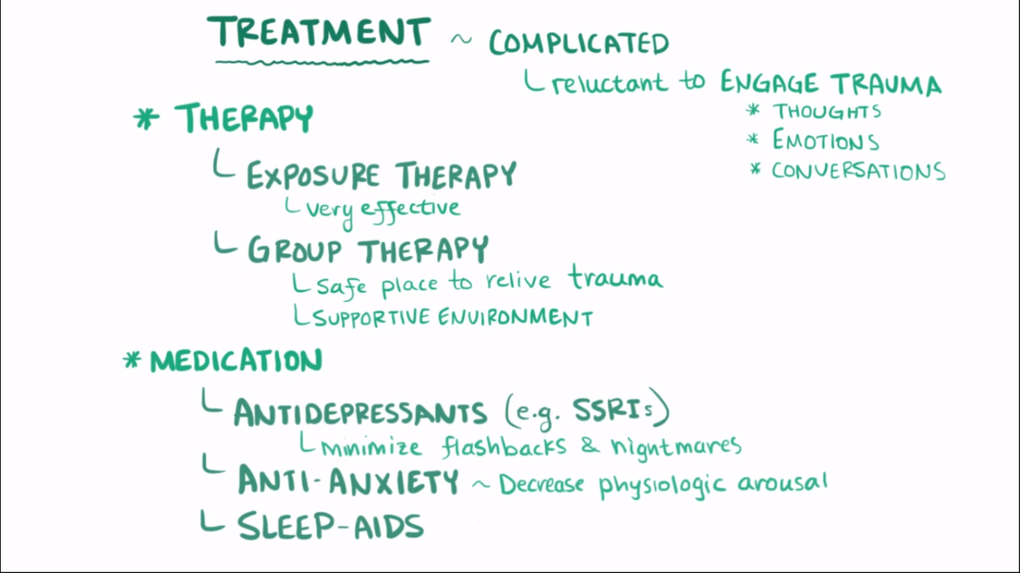
Evidence-Based Treatment Approaches
(Osmosis.org)
Notes:
Tools: gradual exposure, modeling, educating, coping, and prevention-training skills.

Slide 41
“No child - no matter how difficult to manage or how challenging to teach - ever deserves to be mistreated” - Mash & Wolfe (2019, p. 418).

Slide 42
Works Referenced
American Psychological Association. (2009). Publication manual of the American Psychological Association (6th ed.). Washington, DC: Author.
American Psychiatric Association. (2013). Diagnostic and statistical manual of mental disorders (5th ed.). Washington, DC: Author.
Mash, E.J. & Wolfe, D. A. (2019). Abnormal Child Psychology (7th Ed.). Belmont, CA: Wadsworth, Cengage Learning.
Osmosis.org. (2016). Posttraumatic stress disorder (PTSD): Causes, symptoms, treatment & pathology. Retrieved from: https://www.youtube.com/watch?v=hzSx4rMyVjI
Weisz, J. & Kazdin, A. (2017). Evidence-based Psychotherapies for Children and Adolescents (3rd ed.) New York, NY: The Guilford Press.
Wilson, S., Guliani, H., Boichev, G. (2016). On the economics of post-traumatic stress disorder among first responders in Canada. Journal of Community Safety and Wellbeing, 1(2), n.p. Retrieved from: https://journalcswb.ca/index.php/cswb/article/view/6/30

