Slide 1

Incredible Years
March 14th, 2025
Presented by:
Kirsten Lawson Knoop, Lorelei Rendall, Candace Spanjer, and Kourtney Gorham
Notes:
Lorelei
This follow-up workshop offers a brief review of key concepts from Part 1, followed by an in-depth exploration of more strategies as well as practical applications. Enhance your skills and deepen your understanding to effectively implement these strategies with the students you work with.
Need/To-Do:
Permanent and whiteboard Markers, name tags, etc.
Brown paper
Fidgets for tables
coffee
Whiteboards
Blown-up IY Triangle
Cards or candies to pair EAs for initial activity -Lorelei
Copy EA handouts package - Do we want the PowerPoint slides as a handout, too?Lorelei
Grounding Activity
Name the Coaching Style Activity/Game
Plan Positive Opposites Role Plays
Make Self-Care Sheet
Make Works Referenced page on slides

Slide 2

Land Acknowledgement
Prairie South School Division is situated in Treaty 4 Territory. Treaty 4 Territory includes the original lands of the Nêhiyawak (Cree), Nahkawé (Saulteaux), Dakota, Lakota, Nakota (Assiniboine), and on the homeland of the Metis Nation.
Prairie South acknowledges that “We are All Treaty People” and are committed to honouring the Spirit and Intent of the Treaty.
Notes:
Lorelei
Self-Assessment
Start with facilitators. Go around room - write down answers on sheet/whiteboard.

Slide 3
Introductions
Name
School
What do you remember from IY 1.0?
What do you hope to learn today?
Notes:
Lorelei
Self-Assessment
Start with facilitators. Go around room - write down answers on sheet/whiteboard.

Slide 4
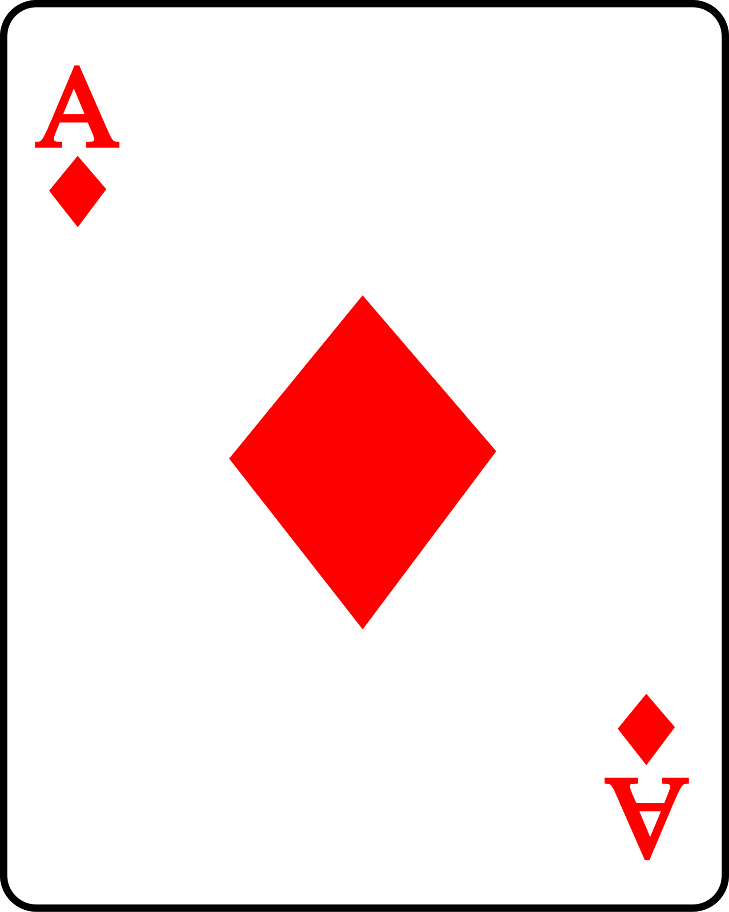
Activity
Pick a card.
Find the person with the same card as you.
Discuss 5 things you have in common.
With the whole group, choose 1 thing you would both like to share.
Notes:
Lorelei

Slide 5
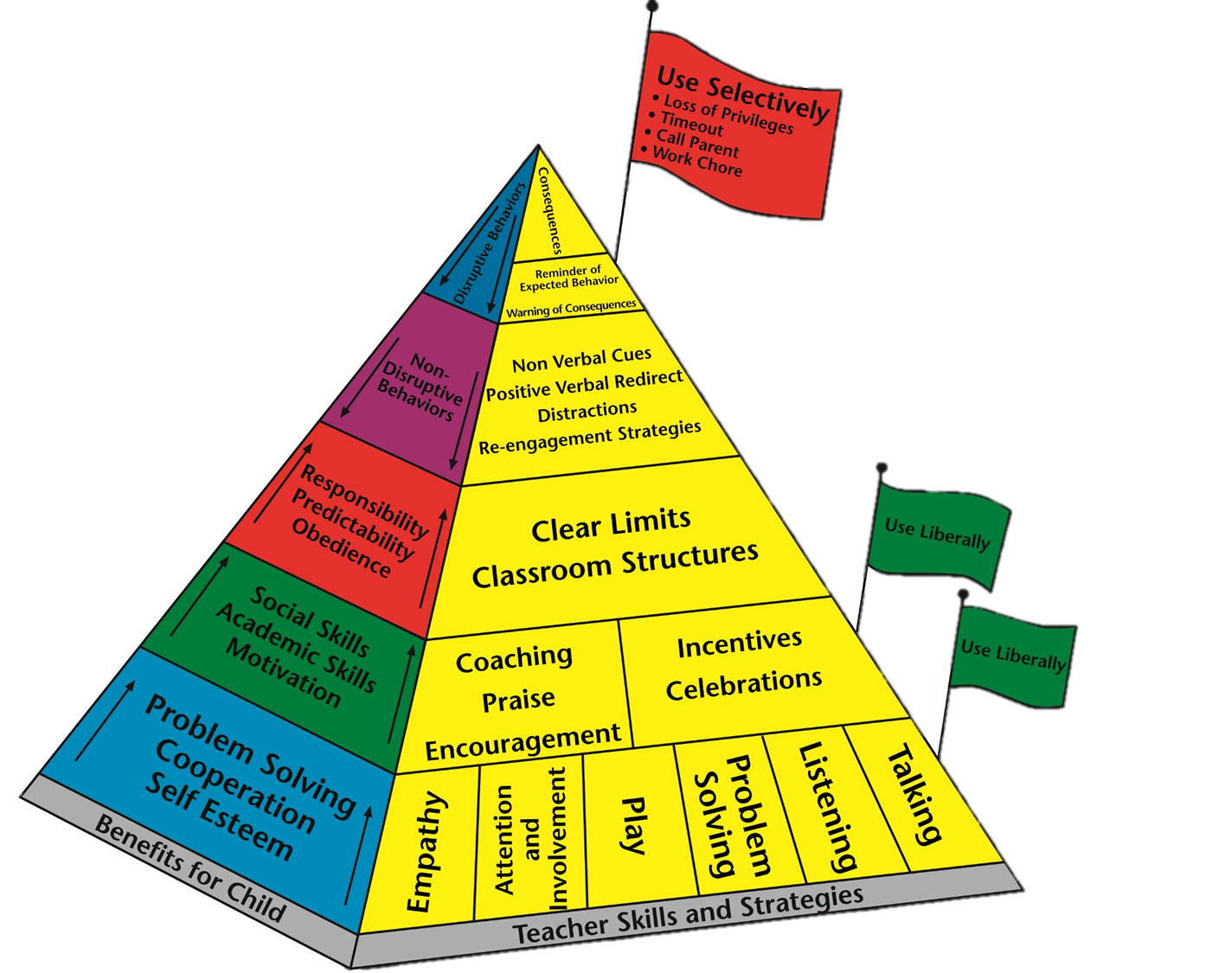
Overview
Morning
Introductions
Review of Incredible Years 1.0
Building Attachment and Connection
  Child-Directed Play
  Fostering Positive Relationships
  Praise and Incentives
  Coaching
Afternoon
Emotional Regulation
Manage Challenging Behaviours
  Limit Setting, Predictable Schedule/Transitions, Planned Ignoring, Non-Verbal Cues, Positive Verbal Redirection, and Re-Engagement
Closing/Reflection
Notes:
Lorelei

Slide 6
Purpose
Fill up our toolbox to empower ourselves and our students!
Connect positive relationships to effective outcomes.
Positive teaching is the greatest gift we can give our students - and it does not cost a penny!
Notes:
Lorelei
What are the challenging behaviours that you are most often working with write on white board? Any diagnosis?

Slide 7

How does IY help us create the right environment for our orchids to flourish?
Notes:
Lorelei
The importance of play with students; this needs to be a integral part of school life and learning. We want students to perceive school as enjoyable, a place where students and teachers trust each other, where individual learning styles and differences are appreciated and respected, and a place of sharing and growth.
Note: They have a Play worksheet in their package.

Slide 8

Building relationships with students with challenging behaviours.
Notes:
Lorelei
What you look for is what you see…
dandelion/orchid metaphor… being a gardener

Slide 9
Review
We start at the foundation and move up.
Notes:
Kirsten
Note: They have a Triangle IY worksheet in their package.

Slide 10
BOTTOM TWO STEPS OF THE PYRAMID FOCUS ON BUILDING ATTACHMENT AND CONNECTION
Notes:
Kirsten

Slide 11
CONTINUING TO FOCUS ON RELATIONSHIP AND PREVENTION OF UNDESIRED BEHAVIOURS
Notes:
Kirsten

Slide 12
USED FOR DISRUPTIVE BEHAVIOURS
Notes:
Kirsten

Slide 13
USED FOR AGGRESSIVE BEHAVIOURS
Notes:
Kirsten

Slide 14
Table Talk:
What have you tried?
What worked?
What didn’t?
Notes:
Kirsten
*Someone take notes of these so we can use them as examples throughout the day*.
Have participant go to white boards in groups to discuss.
Note: place their strategies on the blown-up triangle at front of room/whiteboard.

Slide 15
Bottom of the Pyramid:
Proactive and Positive Teaching Tools
Fostering Positive Relationships (empathetic listening)
Play(fulness)
Praise
Coaching
Notes:
Kirsten
These strategies are to be used liberally, as they form the foundation for supporting children’s emotional, social, and academic learning and will prevent many classroom behaviour problems from occurring.

Slide 16
Fostering Positive Relationships
Think about a student/students with difficult behaviours - what barriers are there when forming positive relationships? Brianstorm with identified group.
How do we overcome these barriers?
Notes:
Kirsten
None of the strategies for managing behaviour that we will talk about later in the session are likely to yield positive results unless applied in the context of a positive relationship between the adult and the student. Building a positive relationship is essential if a student is going to become positive about learning and motivated to cooperate with you and comply with your directions. Of course, we want to build positive relationships with all students - but we know that it’s more difficult to build positive relationships with some children, more than others.
There are several underlying reasons for misbehaviour to occur. There could be developmental, neurological or biological reasons that may cause hyperactivity, impulsivity, lack of language, increased need for attention, and so on. They may be easily distracted and find it difficult to listen and follow directions. Perhaps because of their history, they have low self esteem and unmotivated because they lack belief in their own capacity for achievement. Maybe they are distracted and off-task because they’re hungry or tired. They might be starved for affection and are acting out because of the attention that comes their way when they misbehave.
Whatever the underlying reason is, it’s important we, as the adults, not take the misbehaviour personally. The misbehaviour is not an attack on us, although it can definitely feel like it. Usually it has nothing to do with us. It’s to do with the situation, or maybe something else happening in their world. Maybe they just don’t have the language to explain their emotions, so they are showing it through actions and behaviours instead. Maybe you’re their safe person so they know they are safe enough to be angry with you. There are so many other reasons that could be contributing to misbehaviour.
When we take things personally, that can impact the way we treat our students, and the way we feel about ourselves. Sometimes we may react in ways that don’t make us feel good. That feel out of character for us. When we learn how to not take things personally, it helps our window of tolerance remain wider, which helps us stay calm and co-regulate with the student.

Slide 17
Positive Relationships
Working to promote positive growth in our relationships with students is essential.
A relationship built on trust, understanding, and caring will foster students’ cooperation and motivation, promote their learning, social and emotional development, and their academic achievements in school.
Beyond that, research also indicates that even one caring, nurturing adult in a child’s life can lead to that child having stronger resiliency and better life-long outcomes.
Notes:
Kirsten

Slide 18
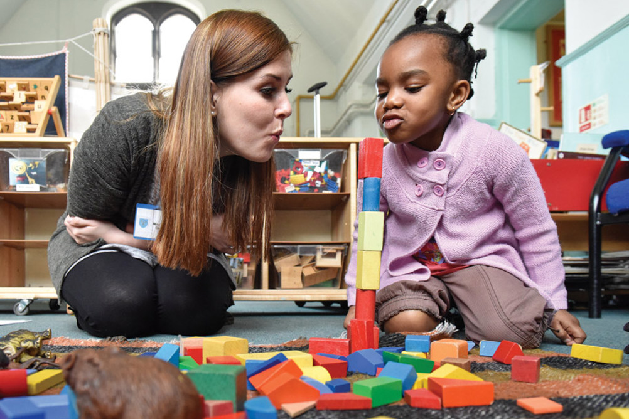
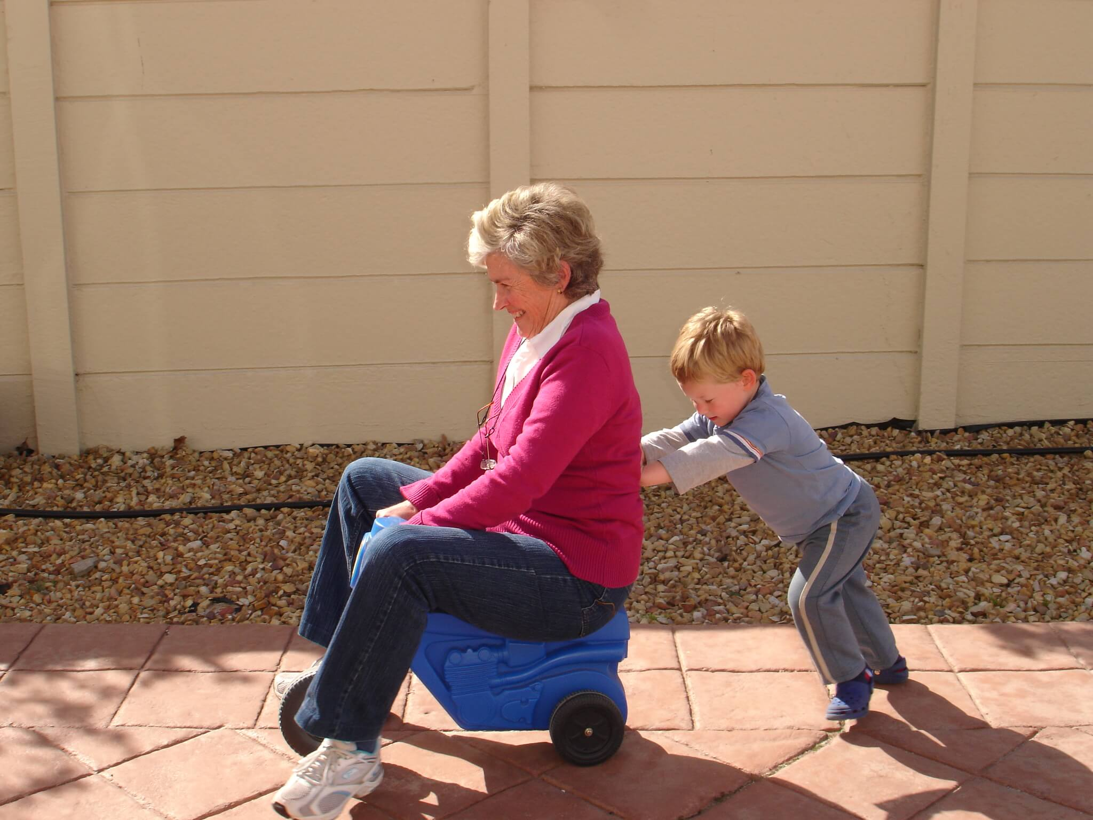
Play and Attention
Hand out: Key Concepts
Value of being child-directed
Value of being undistracted
Appreciative audience
Descriptive commenting
Attachment is strongest when there
is equal engagement!
Notes:
Kirsten
10 minutes to introduce the Key Concepts.
Highlight these skills as foundational for promoting positive behaviour change
About having fun and building relationships with your students
Play with the children
Highlight how play can be used to defuse behaviour
Kids WANT to do well for people they like and know like them

Slide 19
Your connection to the student is where your power lies.
“We rarely come out of the gate with, “I’m going to respect you, you tell me what to think, and then I’m going to decide how I feel about you.” It always happens in reverse. “When you make me feel connected to you, I’ll listen to you all day long.’”
Dr. Jody Carrington, 2019
Notes:
Kourtney

Slide 20
"From this day forward, every time you hear yourself say, that kid is ‘attention seeking or lying’ try to replace that phrase with, that kid is ‘connection seeking,’ and see what happens."
- Dr. Jody Carrington, 2019
Notes:
Kourtney
*Can do a grounding activity here.

Slide 21
Brainstorm Activity:
What are some ways that we can work on building positive relationships with challenging students?
Notes:
Kourtney
How do you think your student would feel if you did that activity with them?
What are some barriers that might come up when trying to use these strategies?
*Can someone put together a list of the offered ideas that we can share with the group at the end? Perhaps we do this for all brainstorm activities so the group can leave with a list*

Slide 22
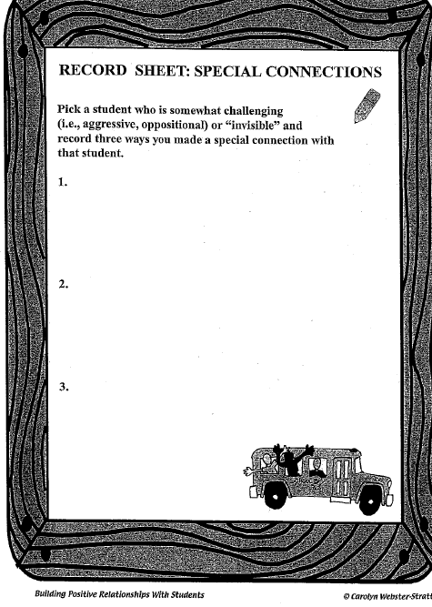
Worksheet Activity:
Record 3 special connections that can be made with a student with challenging behaviours.
Notes:
Kourtney
See: Blackboard Notes re Special Connections and the Special Connections worksheet in package.

Slide 23
Activity:
Drawing activity….
Notes:
Lawson: Descriptive comment/verses questions
See: Blackboard Notes re Special Connections and the Special Connections worksheet in package.

Slide 24
IY Connection Strategies
Active Listening | Play(fulness) | Quality Time (Play at Recess or Lunch) | Forced Choices
Feelings Check-Ins | Focus on the Positives | Fresh Start | Regulate Ourselves
Personalized Greetings | Communicate Your Belief that They Can Succeed | Let Things Go (Planned Ignoring) | Facilitate Opportunities to Help and Connect with Others
Follow Their Interests and Lead | Share About Yourself | Interest Surveys | Narrate Positive Self-Talk
Notes:
Kourtney
Note: Strategies from Incredible Teachers Chapter 2 about building relationships. See p. 79 for Similarities game and other icebreaker activities. P. 81 mentions re choices/positive self-talk. P.85 has tips for play.
Note on Forced Choice:
We love to give kids choices, especially those with behaviour concerns. However, Simplicity Parenting research is showing that we should think twice about how many choices we give. Research shows that children's brains are not developed to make decisions, especially under 7 years and likely not until the teen years (12 or so). So, even if it is a positive decision such as "Do you want to go to the park or to Auntie's house?" the child may appear happy in the moment but in their brain, there are no channels for that decision to go. It stays in the amygdala/brainstem (fight-flight-freeze response) and thus, they feel unsafe and dysregulated (even if there is a delay in that reaction). Responses stuck in our amygdala do not go to our memory centers or decision-making centers of the brain. Children simply do not have the capacity to set the limits and boundaries. They may say, "Yay, I get to go to Auntie's" but his brain says, "Oh no, no one is in charge! Cue our threat response!" Giving ample choices to kids basically tells their brain that they are unsafe because adult brains are the ones with that capacity (thus, why kids crave boundaries).
Note: Unfortunately, our brains also crave familiarity. If an adult stops giving these choices it will lead to long term benefits and better regulation BUT initially, the child will likely meltdown. Dr. Bruce Perry notes that our brains crave familiarity, not necessarily what is safe. I would recommend Forced Choices so the children’s interests and desires can shine, but they also see that you are the safe adult taking charge.
Note: Researchers use this on us - it has been shown that we are more likely to make a purchase with fewer choices so we feel like we “get the best” (aka pick from 3 jams vs. a room full; Costco does this but with each item).

Slide 25

“Someone’s got to be crazy about that kid. That’s number one. First, last and always.” – Urie Bronfenbrenner
Consider:
Do you know their favorite show?
Do you know their middle name?
Do you know what excites them?
Do you know their favorite food?
Do you know the adversity in their lives?
Notes:
Kourtney
A lot of students with challenging behaviours struggle to build relationships with others - it can take deliberate effort on the part of the adults to bridge that gap and help them to develop a sense of belonging within the school and classroom. Often, those that are the hardest to love are the ones who need it the most!
Chances are most of you are working with students with challenging behaviours in some capacity this year whether its in class, on the playground, or at lunch.
One of the things Jody Carrington often discusses is the “light up”. This involves being conscious of how our voice and face reflect our feelings towards someone when we see them. Think about when you randomly run into a good friend that you haven’t seen in awhile - what does your face look like? How does your voice sound when you greet them. This can be a powerful message we send to students about how we value them. If you already have a great relationship with your student, chances are you already light up for them. What about the tough student who can be frustrating to work with - how are you greeting them?
I want you to think about a student you work with. Do you light up when you see them? How much do you know about their personal lives outside of school?
Connection can’t be faked - kids know if we are genuine.
Handout CONNECTION SHEET.

Slide 26

"Kids don’t learn from people they don’t like." - Rita Pierson, 2014
"Kids won’t learn from people who they think don’t like them."
- Dr. Jody Carrington, 2019
Notes:
Kourtney
https://www.youtube.com/watch?v=SFnMTHhKdkw (8 min)

Slide 27
Re-Connection
1. Show genuine interest in things they care about. First.
2. Get their eyes and say their names.
3. Get down on their level.
4. Feed them and they will come.
5. Never leave them - proximity matters - especially when they tell you to go.
(Dr. Jody Carrington, 2019)
“People are hard to hate close up. Move in.” – Dr. Brene Brown, 2017
Notes:
Kourtney
Connection with the “hard kids” can be a lot of work. But it follows the same basic principles:
Show genuine interest in things they care about. First. Talk to them about non-school related subjects, let them teach you about their interests, remember things about their lives, engage in activities with them, use their interests whenever possible.
Get their eyes and say their names. “People are hard to hate close up.” – Brene Brown
Get down on their level. Disclaimer- Know your student, their diagnosis, and their comfort level with personal space, eye contact, and verbal cues. We can differentiate this because the important part is that they know you care, know you are there and feel your support.
Feed them and they will come. You can’t chew and swallow with a flipped lid. - Listen for the “sigh." Jody talks about not viewing food as a motivator or reward but as a way to regulate. Jen shared a story with me that she heard about the staff in a school who hid granola bars strategically in the hallways as this was often where a particular student would have trouble regulating, and they knew that if the student could access the granola bars at times of need, they had a better chance of helping him regulate and avoid greater difficulties. We may need to think outside the box , not just for the food example, but for meeting the needs of our kiddos.
I think sometime we worry that this is rewarding “bad” behaviour. For the record, we have never met a student who changed their behaviour to copy that of a peer in order to “earn” a granola bar. They might have asked "why does so-and-so get a tic-tac and I don't". This becomes as awesome way to engage whole class discussions on fair vs. equal (giving kids what they need to be successful). Jody says, don't die on the snack hill, even if it’s offering a glass of water
Never leave them - proximity matters - especially when they tell you to go. The importance of connection, knowing their safe, knowing you're there if they need you. I often will just stand in the background or down the hall. I never speak the first word…
Other: Show them you're human. Apologize when you mess up. This does not show weakness, it shows strength

Slide 28
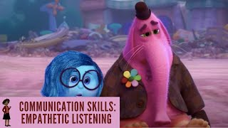
Empathetic Listening
Notes:
Kourtney
https://www.youtube.com/watch?v=t685WM5R6aM (1:44 min)
You don’t have to know someone’s entire story to show empathy. Empathy in fact is sharing emotions, not sharing experiences.

Slide 29
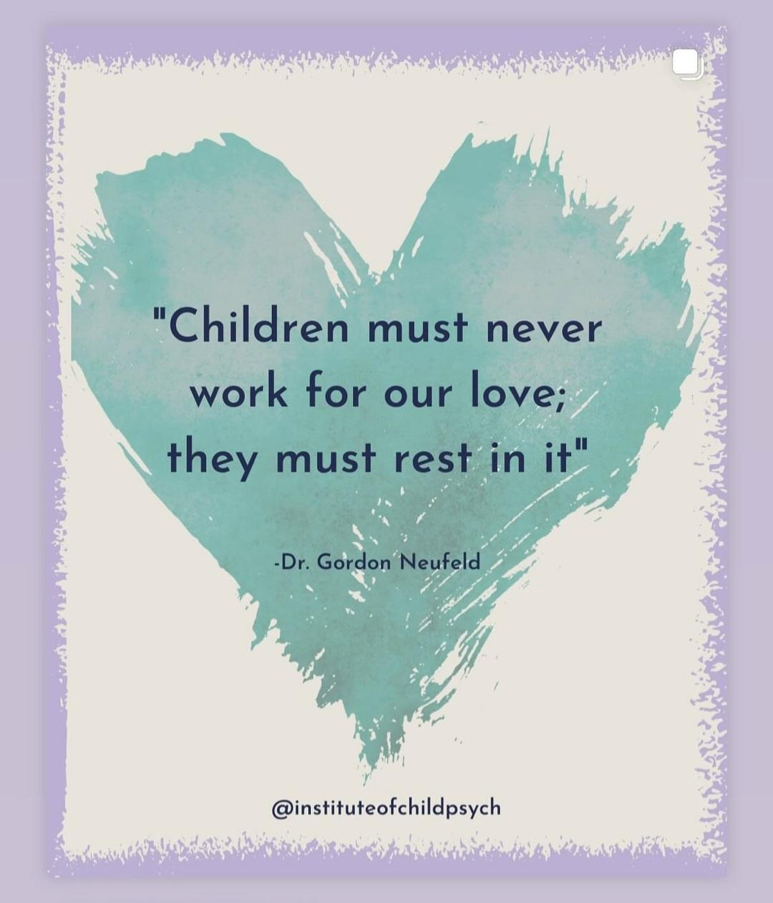


Notes:
Kourtney
10 Minute Timer - Calm Music for Relaxing

Slide 30
Praise and Incentives
Praise - to express admiration or approval of the achievements or characteristics of a person (Cambridge Dictionary).
People sometimes worry about the reliance of external reinforcement and approval. However, decades of research has shown that external reinforcement and approval actually increases intrinsic motivation and reinforcement.
Additionally, those that are praised more often are more likely to praise others and be well-liked (modeled behaviour).
Notes:
Kourtney
From IY Teachers Ch. 5:
External vs. internal reinforcement/motivation/approval - extrinsic actually increases intrinsic.
Also, because praise is a modeled behaviour, those that receive more praise are more likely to praise others and be well-liked by peers.
We all need external motivations at times (one example being our pay cheques) to continue with non-motivating tasks.

Slide 31
Praise and Incentives
“Unfortunately, the children who most need the positive attention and praise rarely get it. The reality of most classrooms is that the problem children receive far more criticisms and negative attention than praise statements or positive attention… Children want attention so badly that they would rather have negative attention for misbehavior than no attention at all.”
Dr. Carol Webster-Stratton, 2012
Notes:
Kourtney
From IY Teachers Ch. 5:
“Children want attention so badly that they would rather have negative attention for misbehavior than no attention at all” p. 198
“Unfortunately, the children who most need the positive attention and praise rarely get it. The reality of most classrooms is that the problem children receive far more criticisms and negative attention than praise statements or positive attention.” - p. 194
ODD/CD: refuse request 70-100% of the time as compared to neurotypical children refuse 35% of the time.
ADHD/ODD/CD: hear 75% more negative words.
Lorelei’s example re children playing and no praise but hit each other and must stop dishes - they get our attention/praise one way or another. Quick brainstorm of what makes praise more effective?

Slide 32
IY Praise Tips
Be Specific | Do Not Add Critiques (i.e. the sandwich approach is not actually praise). | Proximity/Group Praise (i.e. “Table 3 has their books away” or “I love how Bob has his eyes on me.”) | Praise Can Be Subtle (but know that some students need it to be more explicit).
Show Appropriate Enthusiasm | Praise Various Behaviours (i.e. social, academic, etc.) | Non-Contingent Praise (i.e. “It’s nice to see you this morning!”) | Utilize Non-Verbals (i.e. high-fives) and Verbal Praise
Praise Efforts/Progress (not just the end result). | Praise Difficult Students More Often (i.e. 10:1 trauma; 4:1 ADHD; 3:1 neurotypical). | Planned “Catch Them Being Good” | Circulate and Praise All Students (but remember that fair doesn’t mean equal amounts).
Model Self-Praise (i.e. “You must feel proud.”) | Plan the Behaviours to Praise (based on student need). | Model and Encourage Praise to Others and Self | Remember: Behaviour does NOT need to be perfect to deserve recognition!
Notes:
Kourtney
From IY Teachers Ch. 5:
Be specific - labeled, descriptive praise
Give to get principle for adults and children
Instead of critiquing - point out the behaviours you want to see in other kids; sandwich approach is technically not praise. It is better to praise the part that is good, then focus on the negative.
Fair is not equal - Reinforcement or praise for those with trauma needs to be 10:1 positive to corrective but for ADHD and others typically 3 or 4:1. Also, which behaviours we praise is dependent on the student’s individual needs.
Say direction and find a couple students/groups doing it and praise them vs. correcting the few students who aren’t doing it.
Planned - Which behaviours are we looking at (depends on student) and pre-plan the “Catch them being good” or it likely won’t happen at the correct ration. (Idea: Coins in pocket; tallies).
Model positive self-talk to ourselves and others.
Those with inattention may miss praise that is vague; others may need praise in more subtle ways. We still need to praise children that accept praise with difficulty.
See worksheet re praise/encouragement.

Slide 33
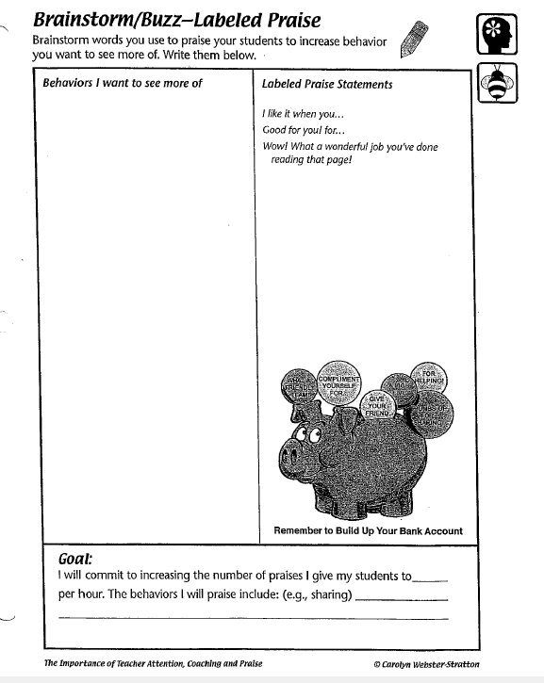
The Way We Use
Language Worksheet Activity:
Notes:
Kourtney
See Labelled Praise Worksheet, Stop Saying You’re So Smart Worksheet and Examples of Ways to Give Praise and Encouragement Worksheets

Slide 34
Coaching and Modeling
Notes:
Lorelei: What is coaching and modeling?

Slide 35
Coaching
Academic coaching: is a non threatening way of bonding and communicating with students and teaching an academic concept without demanding performance.
Persistence coaching: name the child’s internal cognitive state when they are being patient, trying again, staying calm, concentrating, focusing or persisting and working hard with a difficult task.
Social coaching: social skills are need for academic learning and involve self-regulation, how to give and get help from others, work together, listen to others, communicate and problem solve.
Emotional coaching: identifying emotions in others or oneself - this is the first step in children being able to develop empathy for others feelings or viewpoints
Notes:
Lorelei
See sheets on Coaching Children on Cooperative Play, and the Types of Coaching (make into a game)
Ask participants for examples of each.

Slide 36
Name that Coaching Style
*Academic
*Persistence
*Social
*Emotional
Notes:
Lorelei
Name that coaching style activity. Facilitators act it out and participants call out what coaching style

Slide 37


Notes:
Lorelei
45 Minute Timer - Beach Ambience - YouTube

Slide 38
Overview
Afternoon
Emotional Regulation
Manage Challenging Behaviours
  Limit Setting, Predictable Schedule/Transitions, Planned Ignoring, Non-Verbal Cues, Positive Verbal Redirection, and Re-Engagement
Closing/Reflection
We start at the foundation and move up.
Notes:
Kourtney
Morning
Introductions
Review of Incredible Years 1.0
Building Attachment and Connection
Child-Directed Play
Fostering Positive Relationships
Praise and Incentives
Coaching

Slide 39
Emotional Regulation
Emotions are responses to stimuli or situations.
Neurophysiological and biochemical reactions occur (i.e. heart rate, respiration, hormonal secretions, and neural responses).
We “make sense” of our bodily response through our cognitions and affect (ie. “I feel _____.”).
We respond on a behavioural level (i.e. facial expressions, interactions, vocalizations, etc.).
Notes:
Kourtney
From Chapter 11 IY:
Emotions are response to stimuli or situations. P. 407
First, we have an instant, uncontrollable neurophyisological and biochemical reaction (i.e. heart rate, blood flow, respiration, hormonal secretions of epinephrine/cortisol, and neural responses (EEG brain activity)). This is the autonomic nervous system at work.
Then, we make sense of our bodily responses through our cognitions and affect. (i.e. “I must feel ____ because my heart is racing.” This is context-dependent because if your heart is racing while driving through a snowstorm vs. at a rock concert, we attribute that bodily response to different feelings - panic/anxiety vs. excitement/happiness, etc.). Each person may have a different perspective, and thus a different labelled feeling and reaction.
Lastly, we respond on a behavioural level (i.e. facial expressions, crying, withdrawing, interacting, vocalizing, etc.).
Emotional regulation is the ability to adequately control our emotional responses. Dysregulation is when our emotional responses are out of control, dysfunctional, mismatched, etc.
Neufeld information re emotions.

Slide 40
Emotional Regulation
Emotional regulation is the ability to adequately control our emotional responses and match them to the environment/stimuli.
Emotional dysregulation is when our emotions are out of control and/or mismatched to the situation.
Notes:
Kourtney
From Chapter 11 IY:
Emotional regulation is the ability to adequately control our emotional responses. Dysregulation is when our emotional responses are out of control, dysfunctional, mismatched, etc.
There is a time and place for all emotions (they happen in our body for a reason) but the key is being able to match our emotions to the situation.
We are born with this capacity and it develops over time. It can be impacted by the child’s nervous system, their temperament, their developmental level, the adult supports in their life, the stress the child is under, and the school’s emphasis or lack thereof of social-emotional learning - p. 411.

Slide 41
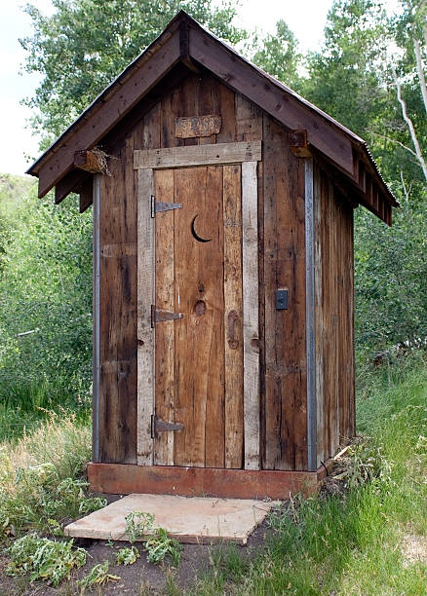
Emotional Regulation
Emotional regulation is a developmental stage and depending on the child and their diagnosis this will happen at different times.
Emotions need to be felt and identified they need to be moved through and we need to help our students do that.
Notes:
Lorelei
Metaphor of outhouse and emotions
From Chapter 11 IY:
Emotional regulation is the ability to adequately control our emotional responses. Dysregulation is when our emotional responses are out of control, dysfunctional, mismatched, etc.
There is a time and place for all emotions (they happen in our body for a reason) but the key is being able to match our emotions to the situation.
We are born with this capacity and it develops over time. It can be impacted by the child’s nervous system, their temperament, their developmental level, the adult supports in their life, the stress the child is under, and the school’s emphasis or lack thereof of social-emotional learning - p. 411.
Emotional regulation is a developmental milestone and in order to regulate our emotions we need to be able be change ourselve, accept the way things are and find out tears/saddnes, have mixed emotions on the subject or have a meltdown

Slide 42

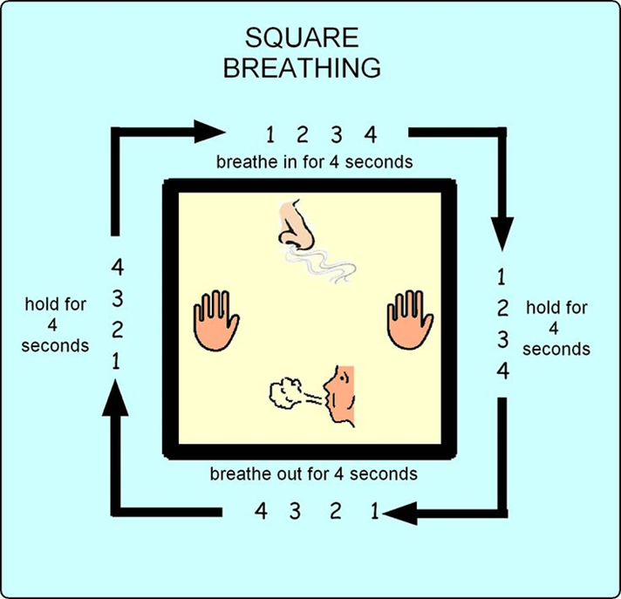
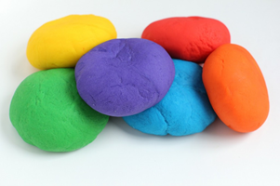

Co-Regulation
“The ability to regulate through the comfort of another is called co-regulation. This on repeat wires up the brain for self-regulation, emotional intelligence, empathetic responses, rational thinking and problem solving.” - Lelia Schott
“I see you feel…”
Notes:
Kourtney
See Co-Regulation Techniques sheet in package.
- Co-regulation: This superpower refers to the way we can use our own emotionally regulated state to affect the emotional state of others.
- The simplest example might be the way an infant will settle when picked up and soothed by a loving caregiver. You may have noticed when you are calm or excited, the people near you may join you in that emotional state.
- This practice works on the brain and nervous system and happens whether you are aware of it or not. So, why not use the power with intention and purpose?
-Importance of co-regulation: Once you discover the power of co-regulation, you can employ this strategy when helping an upset child, reducing the emotional charge in a meeting, or building excitement for others. The key is to recognize when you are contributing to helpful or unhelpful co-regulation experiences.
- We have to regulate first!
- If someone is dysregulated, they are in their nervous system or brainstem response. They will likely not be able to expressively or receptively communicate. Instead, they communicate through senses and emotions so our tone of voice matters and actually us breathing matters more than getting them to do it.
- We need proximity to do this work.
Other strategies include:
Various breathing strategies (some online or with physical items like a feather, our hand with Take 5 breathing, a pinwheel, a breathing ball, etc.)
Food/water - can’t flip lid while chewing/swallowing.
Visuals
Tactile items
Safe space with you modeling strategies.
Validating feelings.
Grounding with items in the environment.
Getting outside/changing environment.
We have to model our own feelings, our own coping strategies, our own breathing, etc.
When calm there are other things we can do - lessons on emotional identification, role plays and games, teaching coping strategies, discussing and modeling feelings, feelings thermometers, puppets, normalizing all emotions, recognizing body cues, praising regulation moments/efforts, discuss expected/unexpected behaviours, etc.
Funny clip from Kimmy Schmidt that shows a co-regulation strategy ?
https://youtube.com/shorts/HqiS3elZMEs?si=cYxVn1jZ79YWxrjH

Slide 43
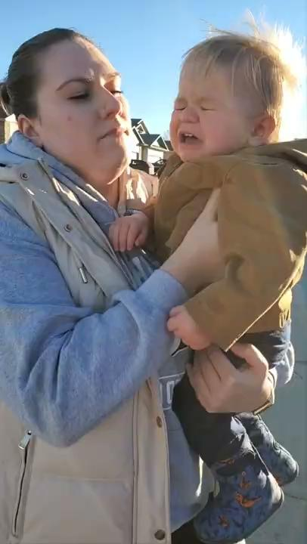
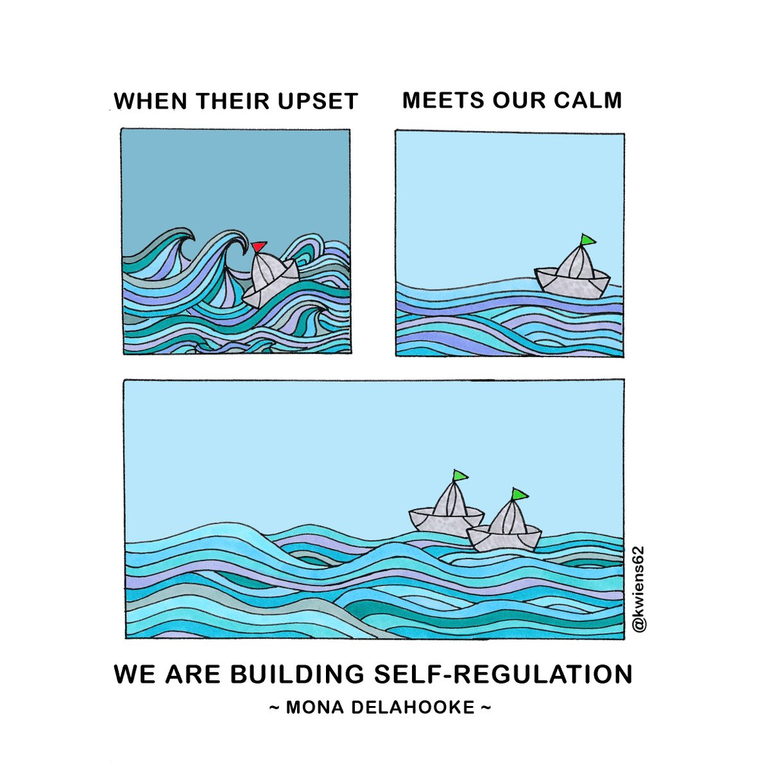
Our Job is to Be the Model: Regulate Ourselves
Notes:
KOURTNEY
-We can’t control another person’s emotions, their use of a coping strategy, etc.
- What we do control is ourselves. Our job - our only job in the face of dysregulation - is to be present and be the model. We must regulate ourselves.
- If the kid joins in, great. But that’s not our job.
Breathing is so effective that my 14 month old son learned to do it after 1-2 tries. This is an example of him at 16 months.
-He is generally happy but transitions inside or falls can make him upset. From 12-14 months before I did breathing work with him, it would be about 1 minute or more of crying. Now it is less than 60 seconds. In this instance it took 10-15 seconds and we were both going inside and he had fallen (double whammy).
-It works every time to reduce his time upset. That doesn't mean he never gets upset, but it truly works! Why? The caregivers in his life are leading him through calm. On a brain level this is regulate, relate, reason in action! We are co-regulating via the mirror neurons in our brains.
-Notice – my son doesn't always take the breaths with me and it still works!
-I understand that I have a relationship with him, he's a regulated and happy kiddo, and he's little and I can put him on my lap and rock him, or pick him up, etc. which we can't do with our students... but this can still be applied in all classrooms and across all ages of kids (and even the adults we work with). The key is quiet (limit verbal instructions and rationalizing) and modeling calm by taking those deep breaths.
-How do you think it would have went had I rationalized with him (ie: "We were out for an hour... we'll go out again.. This is a little deal.")? What about if I showed panic after a fall? How would this be met by the staff around you?
-FYI almost all of Matthew's grandparents questioned what I was doing when they saw this in action! Staff may too - "Where is the consequence?" Etc. But sometimes you just have to, figuratively speaking, ignore your mother-in-law.
-I truly hope you are sold on the magic power of pausing and taking some deep breaths – even if only for yourself because you deserve to feel calm!

Slide 44
Emotional Regulation
"It’s only through relationships that we teach kids to regulate emotions. And if they don’t have control over their emotions, they can’t learn or connect."
- Dr. Jody Carrington, 2019
Additionally, “we support the development of emotional regulation by providing environmental stability and consistency in the classroom as well as a supportive and nurturing atmosphere.”
- Dr. Carolyn Webster-Stratton, 2012
Notes:
Kourtney
"It’s only through relationships that we teach kids to regulate emotions. And if they don’t have control over their emotions, they can’t learn or connect." - Dr. Jody Carrington
Remember: base of the triangle is that relationships are the foundation. If we want to co-regulate, and then to teach, we need that relationship.
The hard part of teaching is that we are doing the base of the triangle along with all of the other pieces. We also need to provide boundaries, stability, consistency, etc. to support student’s emotional regulation and overall development. - p. 412

Slide 45
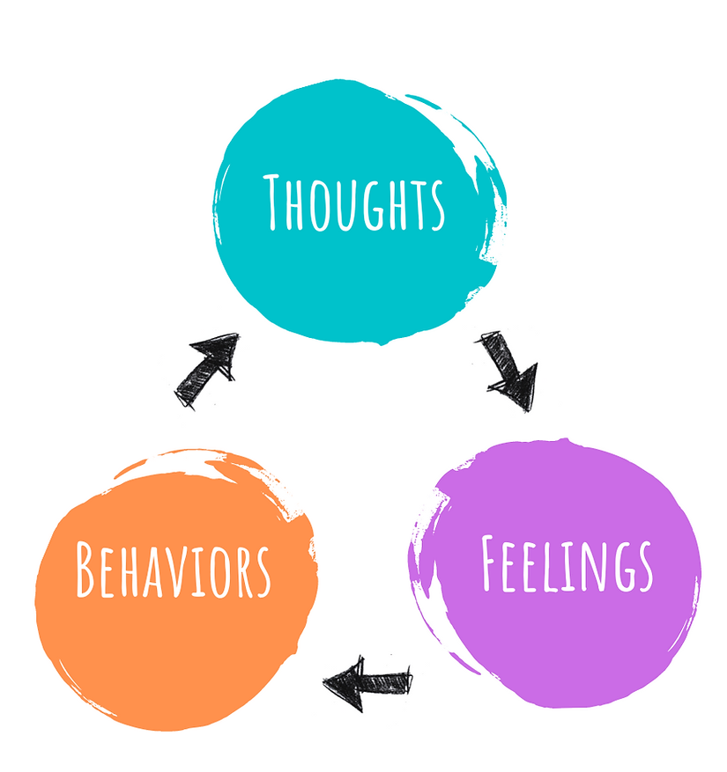
Managing Our Emotions
Be Aware of Your Own Thoughts
→ Thought Interruption/Challenging
→ Be Objective (i.e. Don’t Make it Personal
or Speculate About Their Intent)
→ Normalize Challenges in Life
Increase Positive Thoughts
→ Focus on Coping Strategies
→ Self-Praise vs. Self-Critique
→ Humour
→ Positive Support Systems
Notes:
Candace
From Chapter 15 IY:
See negative thoughts rewriting worksheet
Research is clear re thoughts → feelings → behaviours
1. Be Aware of Your Thoughts - not to control but then we can do thought interruption. We get to choose how much time we spend in negative thoughts.
We can challenge automatic negative thoughts.
We can refuse negative labelling, speculation re other’s intent, and can be objective (i.e. Johnny hit 3x vs. Johnny hates me.)
We can normalize challenges in life and know we have persisted through every challenge thus far (i.e. paint a positive future). Behaviours in kids are normal/expected and we can have flexibility with them and ourselves.
Take a break if you are angry.
2. Increase Positive Thoughts
Avoid self-critique - use self-praise
Support systems - “Misery loves miserable company” so pick a support system that is positive and has humour.
Focus on coping strategies?
What coping strategies do you use?

Slide 46

Whiteboards Activity:
Part 1: What are we telling ourselves when we are dealing with challenging behaviours?
Notes:
Candace
What are we telling ourselves when we are dealing with challenging behaviours?
Brainstorm at boards give 5 common thoughts and have them reframe.
Things I can do to stay calm/things I can say to myself to stay calm.

Slide 47
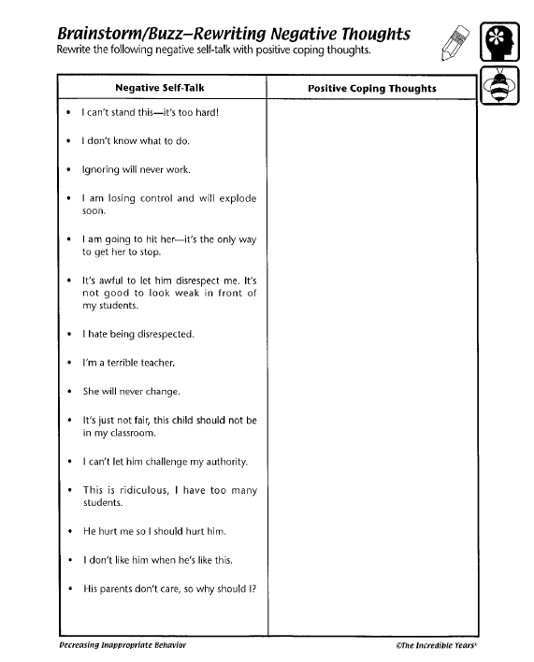
Reframing Negative Thoughts Worksheet Activity:
Notes:
Candace
See Reframing worksheet.

Slide 48
Whiteboards Activity:
Part 2: What are some things we can tell ourselves or do to be regulated?
Notes:
Candace
Things I can do to stay calm/things I can say to myself to stay calm.
Need: Grounding Activity-

Slide 49
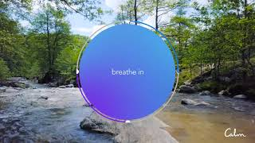
Notes:
Candace
Breathing bubble CALM pp.
https://www.youtube.com/watch?v=uxayUBd6T7M - 1 min.

Slide 50
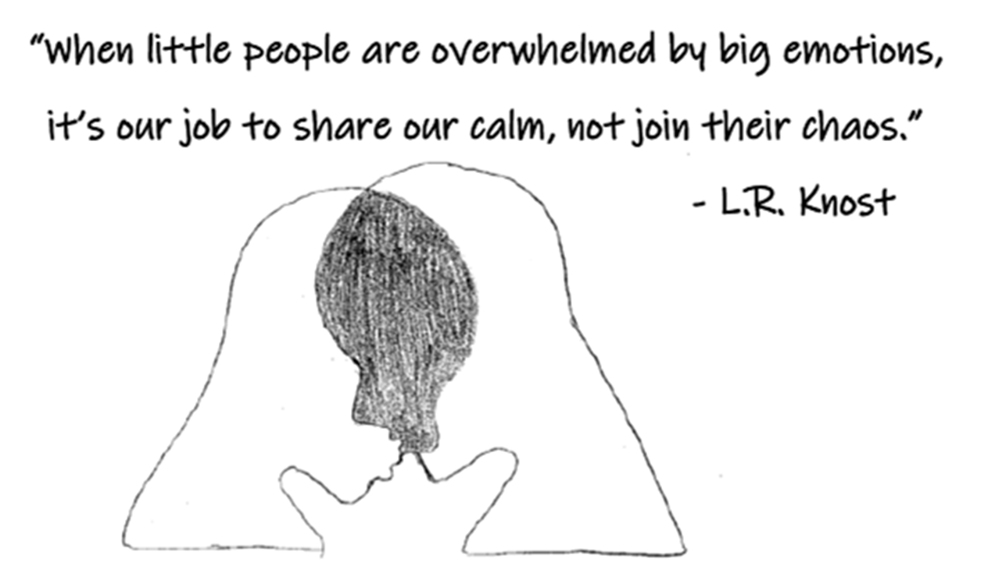
Notes:
Candace
10 Minute Timer - Calm Music for Relaxing

Slide 51
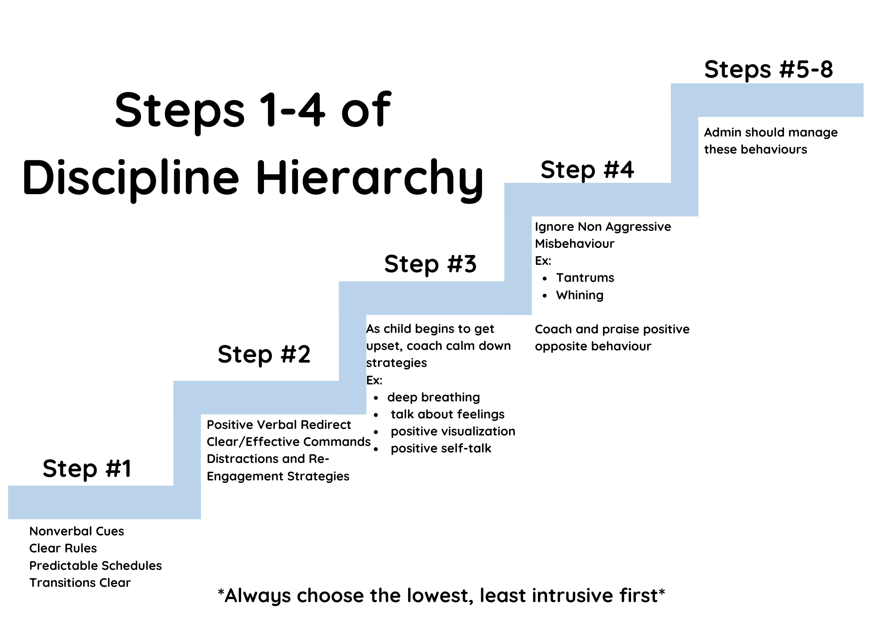
Managing Undesired Behaviour
Notes:
Candace
Despite our best use of proactive strategies, children will always continue to misbehave. This is actually a necessary part of children’s development and healthy for children to do. It’s their drive for independence, their curious exploration and discovering the limits in their environment. There is a lot of learning that comes out of misbehaviour. Children learn what’s social acceptable and what’s not, they learn emotion regulation skills, conflict resolution, boundaries, and so much more.
However, misbehaviour without consequence, or ineffective consequence, will also have a big impact on how a child learns from those experiences. They may think the behaviour is socially acceptable, they don’t learn how to have healthy conflict resolution, they are stuck in a dysregulated state for longer and struggle to learn emotion regulation, and so on.
The next layer of the pyramid introduces the use of the least intrusive discipline teaching tools, which are used to prevent and reduce specific targeted behaviours. These are non-aggressive misbehaviours such as whining, getting out of their seat, not listening, back talking, tantrums, etc.
See handout on challenging behaviours.

Slide 52
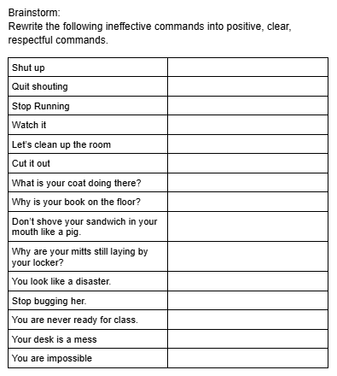
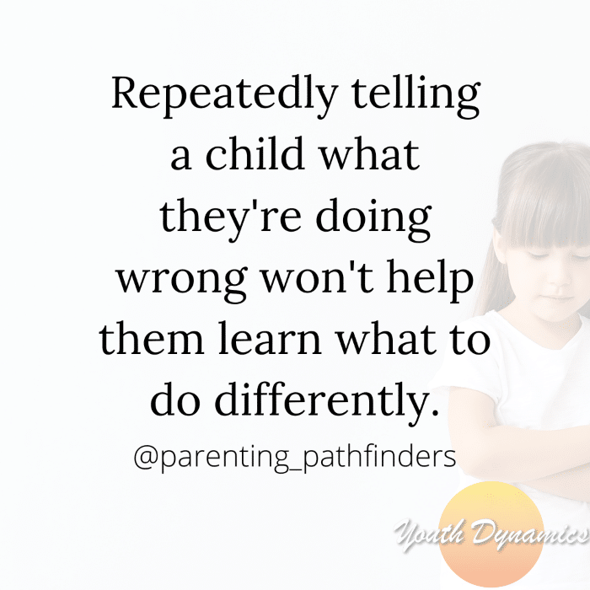
Giving
Clear & Effective Commands
Notes:
Candace
Research tells us that the typical child will fail to comply with an adult’s request about 1/3 of the time, while children with ODD or Conduct Disorder will non-comply about 2/3 of the time or even more. School aged children may argue, swear or protest when an activity or object is denied. This is normal behaviour and healthy expression (to a point) of a school age child’s need for independence and autonomy. When these things happen, don’t take them as a personal attack (the usually aren’t). The child is trying to test the limits to see if the adult is going to be consistent, and if we aren’t consistent, they will test harder the next time.
Over the next several slides, we are going to be talking about ways to handle disruptive/non-compliant behaviours when they occur. However, it’s also possible that part of the reason for noncompliance may be the result of the way the rules or instructions were delivered. Instructions that are vague, such as, “settle down”, or “show me you’re ready” can be difficult for a child to follow because they don’t tell the child what behaviour is expected from them. Commands that are expressed as criticisms like “seven year olds don’t do that”, “Why can’t you follow the directions?” or “You never listen” are more likely to lead to resentment and opposition than the desired behaviour. Negative commands that say what behaviour you want stopped but not what you want done, also fall into this category. “Stop running”, “Don’t hit”, leave it up to the child to decide what to do instead. Example: telling a child not to hit, so he kicks instead. Commands expressed as questions, such as “Do you want to put your name on your paper?” can confuse children because they can’t tell whether they are being given a command or a choice.
What we want to give is clearer, short, specific commands and instruction expressed in a positive way. So we’ll talk about some ways the research has shown to maximize the effectiveness of commands.
Allow for lead time: Sometimes we give commands without wanting. A child may be absorbed in painting and we walk over and tell them they are done and to put it away, then we are frustrated that they ignore us, or complain. We may still get pushback for some kids, however, we do know that giving lead time can help commands be more effective, so if a student is reading a book, a we can say “when your finished the page that you’re on, I want you to put your book away”. And sometimes we can be responsive to reasonable requests from the child too, and we’re more likely to obtain compliance from them than if we are always expecting immediate compliance. In this case, the child might say, “I only have 1 more page until the end of the chapter. Can I read just one more page?”.
Use students name and gain eye contact: With this I do not mean “look at me when I’m talking to you, Sally”. But rather, getting their attention so you know that they heard you. This may require that we go right up to the child, kneel down, and place our hand on their desk before repeating their name and stating the request. Sometimes children are so immersed in what they are doing, that they quite literally do not hear us, and this can appear to be non-compliance when it’s actually not.
Clear positive commands: We want to use “do”/”start” commands. “Sit in your seat”, “Write your name at the top of the paper”, “Walk slowly”, “Face this way”. The action verb is the first word in the command and it’s hard for students to miss.
There are a lot of ways we give unclear commands. Vague, non-specific commands such as “knock it off”, “watch out”, “Show me when you’re ready”. These statements can be confusing because they do not tell the student specifically what behaviour is expected. And it can sometimes to hard to remember that not every child just knows what is expected of them. Their home lives may be very different, their cognitive abilities may impact their ability to understand what you mean, maybe this is the first time they’ve ever received this command so it doesn’t make sense to them.
Another type of unclear direction is when its stated as a descriptive comment. So things like “You’re getting mud all over the floors”, Billy, your book isn’t open”. There are two problems with these kinds of statements. First, they contain an implied criticism, pointing out something that the teacher is clearly unhappy with. This is likely to breed resentment in the student, which does not lead to cooperative behaviour. Second, while a command may be implied in these statements, the adult never actually says what they would like the student to do.
A third type of unclear directions is the “Let’s” command. This sounds like “Let’s clean up the art table”, “Let’s finish drawing”. This can be confusing, especially be confusing for younger children, especially if we have no intention of becoming involved. If we say “Let’s put the play dough away” and we intend to help them put it away, then it’s actually an effective way to communicate. On the other hand, if that’s not the adults intention, then that direction is confusing, misleading and unfair.
Question commands can also be confusing for children. For example, “Are you supposed to be over there? I didn’t think so”, “Are we supposed to be sharpening our pencils right now?”. The issue here is the subtle distinction between a request and a command. A request implies that the student has the option of choosing to comply or not,. Another issue with question commands is that we can find ourselves backed into a corner. If we say “Would you like to put your book away now?”, “Do you want to put your name on your paper?” or “Can we clean up?” the students me legitimately answer “no” because these are yes or no questions. Having a choice is implied in these statements.
Reduce the number of commands: Research indicates that that adults give approximately 35 commands every 30 minutes. Children who have more behaviours receive around 60 commands in half an hour. Research also tells us that as the number of adult commands increases (particularly critical or negative commands) so do the number of undesired behaviours. Sometimes we can find ourselves giving commands because the child is doing something that is bothering us but they aren’t really a big deal. Things like “quit wiggling”, “stop fidgeting”, “Colour the frog green, not yellow”. These commands are unnecessary. We have to remember that if we are constantly giving commands, it’s nearly impossible for any child to comply every single time.
One command at a time: “It’s time for recess. I want you to put your markers away, pick up your papers and put them in the tray, go to your locker and get your coat, and making sure you put your toque on too, it’s cold, and then get going outside”. A series of commands like this is difficult for children to remember. Most children can only retain one to two commands at a time. When we are giving a string of commands, we’re also not giving ourselves time to notice who is complying and to praise them for it. Another type of chain command is saying the same command over and over again. Children will learn that there is no real need to comply until you get to your fifth repetition of the command. Instead, we should give a command once, slowly, clearly, giving them time to comply, and praising when we see compliance (even little bits of compliance).
Allowing time to comply: As I said just a second ago, time to comply is important. Sometimes immediate compliance is necessary, like when there are safety issues and we have to intervene, but for the most port, when there aren’t safety concerns, we should be giving the child the opportunity to succeed at complying. Some children may need more time allowances than others, depending on processing time.
When-Then commands: Using When-Then commands tells the child in advance the exact positive consequence of their actions. “When you finish putting the paints away, then you can go outside for recess”. Once we’ve given the When-Then command, its important to ignore all protests and arguments, adn to follow through with the consequences.
See rewriting commands worksheet

Slide 53

Non-verbal cues (signals, prompts, pictures)
Flat palm moved downward through the air (for quiet down)
Thumbs up (good job)
Wink (good job for working hard)
Exaggerated deep breathing (calm down)
Picture cue - Red light for absolute quiet, yellow light for quiet talk while working, green light for free play.
The “stare” - catching the child’s eye
Reminder cards (stop signal, quiet hand, show my five hand)
Complement card
Volume turning down signal
Proximity - Approach and place hand on desk
Raised eyebrow
Notes:
Candace
Sometimes it can be as simple as a non-verbal cue to get a behaviour under control.
Some examples of non-verbal cues are….

Slide 54
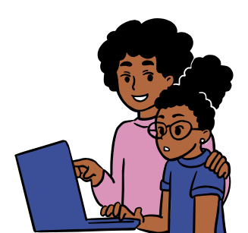
Positive Verbal Redirect
Notes:
Candace
Try to avoid negative verbal redirections such as “Didn’t you hear the instructions?” or “Well you weren’t listening and talking to your neighbour instead”. These redirections do little to help the student become more productive. Another ineffective verbal redirection is “Why” questions. “Why did you do that?”, “Why did you cut in line?”, “Why are you out of your seat?”. All we’re likely to get out of them is “I don’t know” and often times, they truly don’t.
A student is complaining that another student took the scissors they wanted to use “Sally, it looks like you need some help getting started. Have you decided which colour you’re going to start with?”
A student is “clowning” around during math class. “Show me how you’re going to do this first problem”.
We are ignoring the behaviour and redirecting the student to what they should be doing.
Now for some students, sometimes we can redirect them by simply just saying their name. This is giving them minimal attention for the misbehaviour, but it can still be very effective for some of our students.

Slide 55
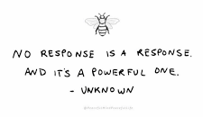
Ignore
(Non Aggressive Misbehaviours)
Notes:
Candace
Ignoring can be one of the most powerful tools we use when trying to manage undesired behaviours, however, it’s also arguably one of the hardest strategies to use, and there’s a few reasons why.
First, our mindset. Ignore can feel like we are doing nothing and letting the child get away with the undesired behaviour. This typically leads to us thinking “well I have to do something to stop this because the child is going to keep doing this all the time since they are getting away with it”.
Second reason, is that we have a natural tendency to attend to children who are out of their seats, being disruptive or being argumentative. Undesired behaviour is easy to see, easier to catch our attention, where expected behaviour doesn’t catch out attention because that child is doing exactly what they are supposed to be doing so why would it.
The next reason is because we have a hard time staying regulated when undesired behaviour is happening. It can be uncomfortable, frustrating, overwhelming, everything in between, and we want it to stop.
However, adult attention only reinforces that behaviour.
Research has also shown that planned ignoring, in combinations with differential reinforcement, is extremely effective for reducing inappropriate behaviour in students. Ignoring can be a powerful tool for modifying behaviour as it deprives the child from the attention that they are seeking. While ignoring is highly effective, it is probably one of the hardest tools to actually use.

Slide 56
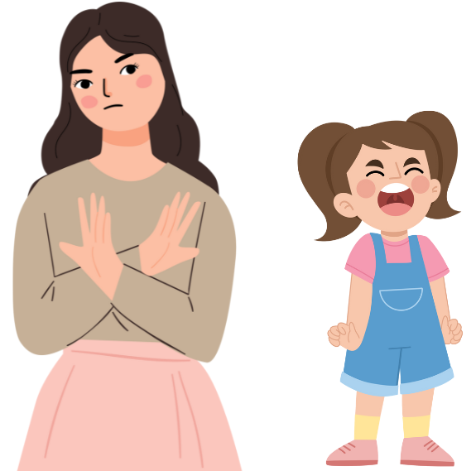
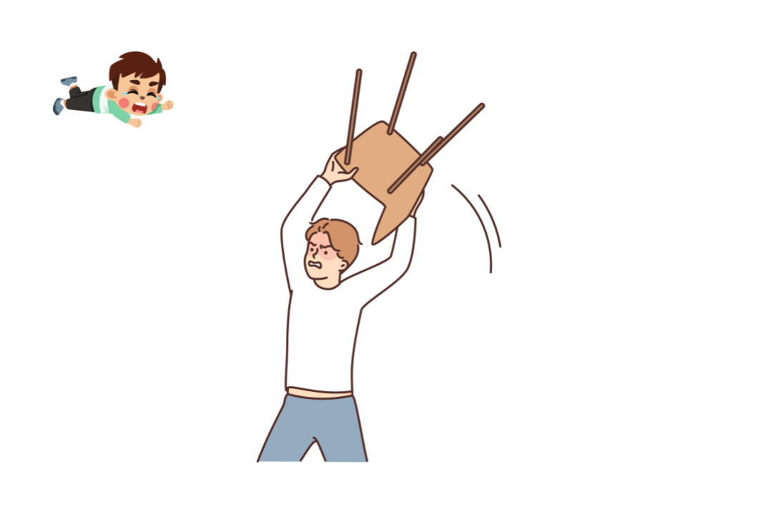
How to Use Ignore Effectively:
Notes:
Candace
Choose the behaviours to ignore: (Limit the Number of Behaviours to Ignore)
Lower level attention seeking behaviours such as whining, teasing, arguing, eye rolling, pouting, calling out or tantrums (i.e. behaviours that are not dangerous or hurtful to others)can often be decreased if they are systematically ignored. Sometimes we feel that ignoring isn’t discipline. It can feel like if we ‘let’ it happen, thats showing the child that we are okay with it happening. However, when we do ignore, we are ensuring there is no payoff (or power) to the student for continuing the misbehaviour. They aren’t actually getting what they are seeking. By not giving the misbehaviour attention, the adults are also not engaging in a power struggle with the student. If the planned ignore is maintained, the student will usually stop what they are doing because it doesn’t achieve their goal of getting an adults attention.
Sometimes we think we are ignoring the students misbehaviour when we are actually continuing to give it considerable attention. We may stopped talking to the student, but continued glaring, grimaces, or in other ways of letting the student know that the misbehaviour is affecting them. Effective ignoring occurs when the adult is able to neutralize their reactions to what the student is doing. The adults facial expressions should be neutral and eye contact is avoided are stopped. Ignoring can also involve moving away from the student. Just as the most powerful form of positive attention includes moving closer with a smile, eye contact, and verbal praise, the most powerful form of ignoring is a neutral expression involving no eye contact, no communication and turning away of the body.
This, in combination with the student receiving coaching and praise for the positive opposite behaviour (speaking calmly, sharing, cooperating, staying calm), they will learn it is more beneficial to behave appropriately than inappropriately.
But here’s the thing, if we just use planned ignore, and do not use coaching and praise of the positive opposite behaviour, the child isn’t going to learn that appropriate behaviours get them more attention.* Planned ignore and coaching & praise must be used together*
Use consistent ignoring - be prepared for the misbehaviours to get worse at first:
Most children will initially react to ignoring with an increase in negative behaviour to see if they can get that attention back. It’s how they are used to getting the most attention and now it’s suddenly changed so they are trying to get it back in the way they know how. If the negative behaviour increases and we give in because it’s become too much for us, we’ve begun to create an even bigger problem. They learn if they misbehave long and hard enough, they will get what they want in the end. This only reinforces the inappropriate behaviours. The next time you try ignore that same behaviour, the child will most likely respond with more elevated behaviour because they know that they can successfully get your attention back by doing so.
Ignore Should be Subtle:
If we have a kiddo who begins to pout, sulk, mutter, roll their eyes, etc., and we respond by making an exaggerated gesture of pulling away and disregarding the behaviour, then it can be almost as reinforcing as giving our attention to the behaviour in the first place. We are showing the student that they are able to produce an emotional response from the adult and still feels like attention. It’s important that we learn to neutralize our emotional reactions and facial expressions, and be subtle about it.
It’s also helpful to use subtle ignoring for secondary behaviours. For example: you ask a child to go clean up their workspace before they go out for recess. While they are cooperating with your request and are starting to clean up, you can hear them mumbling, moaning, sulking and sighing. Here, we can focus on coaching and praising their compliance to our request and ignoring the secondary behaviour. “Thanks for cleaning up your workspace, buddy!” instead of “Excuse me? Do not take that attitude with me”. It’s okay that the child doesn’t enjoy doing a chore. The child is complying, and that’s what’s important!
Ignore AND distract:
Choosing to ignore undesired behaviours doesn’t mean that there is nothing positive you can do to improve the situation. In fact, failure to provide distraction or suggestions for alternative. More appropriate behaviour can lock adults and children into a power struggle and cause prolonged misbehaviour.
Example: Johnny asks if he can use the paints and his teacher tells him no. Johnny begins yelling and screaming at the top of his lungs. His teacher effectively ignores the tantrum by walking away, and in a couple of minutes the screaming subsides. Johnny’s teacher is still on the other side of the classroom, not paying any attention to Johnny. Johnny begins to scream again. Why do we think the teachers attempt to ignore didn’t work?
In this example, Johnny did not experience the benefits of getting attention for positive/expected behaviour when his tantrum stopped. From his view point, his teacher did not hear him and he needs to try harder to get their attention.
In the scenario above, once Johnny stopped screaming, his teacher could have returned to him, giving him attention and suggesting some other interesting activity that he could do that was more appropriate.
In another example: A student starts whining about not being allowed to use the Chromebook. The teacher ignores her until the whining stops, and then asks her if she wants to help clean the fish tank.
An important piece to this is that once the undesired behaviour stops and the expected behaviour begins, we want to give them attention within a matter of seconds (usually within 5 seconds). Is it possible that the behaviour may start back up when we give them attention? Yes. and then we return to ignore the behaviour until the expected behaviour comes back, then we return our attention.
Another way we can combine ignore and distract is to distract ourselves. We can do this by helping other students (which gives us the opportunity to use proximal praise and attention for positive behaviours), or just involving ourselves in something else. When the child begins to do expected behaviour, we return quickly return our attention back to the student and coach and/or praise them for their expected/cooperative behaviour.
Move away, but stay nearby:
It may seem reasonable to ignore a student’s behaviour by walking to the other side of the room. This can be an effective technique if the child is clingy and physically demanding attention. However, the difficulty with going too far away is that the adult won’t be able to pay attention to and reinforce the appropriate behaviour as soon as it returns. When we are ignoring, it’s best to physically move away, but staying nearby. This way the adult can monitor the student’s behaviour and return our attention back to them, reinforcing the positive behaviour, as soon as the undesired behaviour stops.
Certain Behaviours Should NOT be Ignored:
Dangerous or abusive behaviours, including hitting, verbal abuse, running away, and damaging property should not be ignored. Bullying a classmate, lying, or stealing should not be ignored either. In these situations, we recommend consulting with admin on how to respond. .

Slide 57
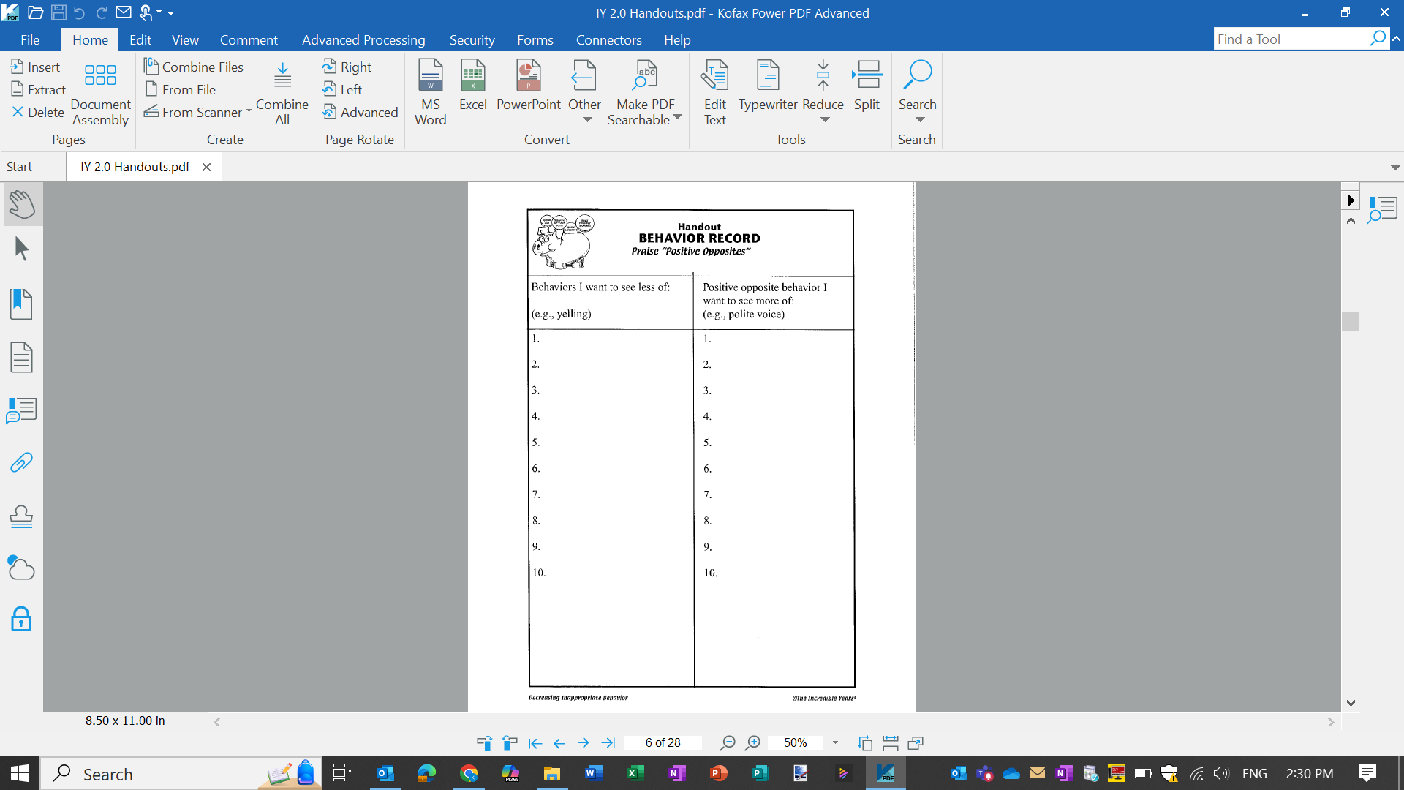
Praising
“Positive Opposites”
Worksheet Activity:
Notes:
Candace
Praising the behaviour that we want to see more of, while ignoring the behaviours we want to see less of, reinforces the “positive” behaviours.
*Proximal praise*
See “Positive Opposites” Worksheet, Blackboard Notes on Praise, and Praise Suggestions from IY handouts
We need to be intentional about what we are going to do differently to be more effective.

Slide 58
Notes:
Candace
I want to reiterate a point that was said earlier in the day…..None of the strategies for managing behaviours are likely to have positive results unless applied in the context of a positive relationship between the adult and the student.
This does not mean that we can’t use these strategies to manage behaviours until we have already formed a positive relationship. The thing about the IY pyramid is that all of these steps are being used in unison. We’re never just focusing on the first level/ the base of the pyramid without also applying the next level and the next level and so on.
We can be playing with a child as we praise and coach them, we can set clear limits at the same time, giving non-verbal cues, re-direction, etc.
Example or role play: “Taco Cat Goat Cheese Pizza”. Raised eyebrow, slow motion movements. When acceptable behaviour occurred, child was rewarded with me moving at normal speed again.
*explain how this taught the student my boundaries and expectations, and what was socially acceptable behaviour when playing a game, while still laughing and having fun together*

Slide 59
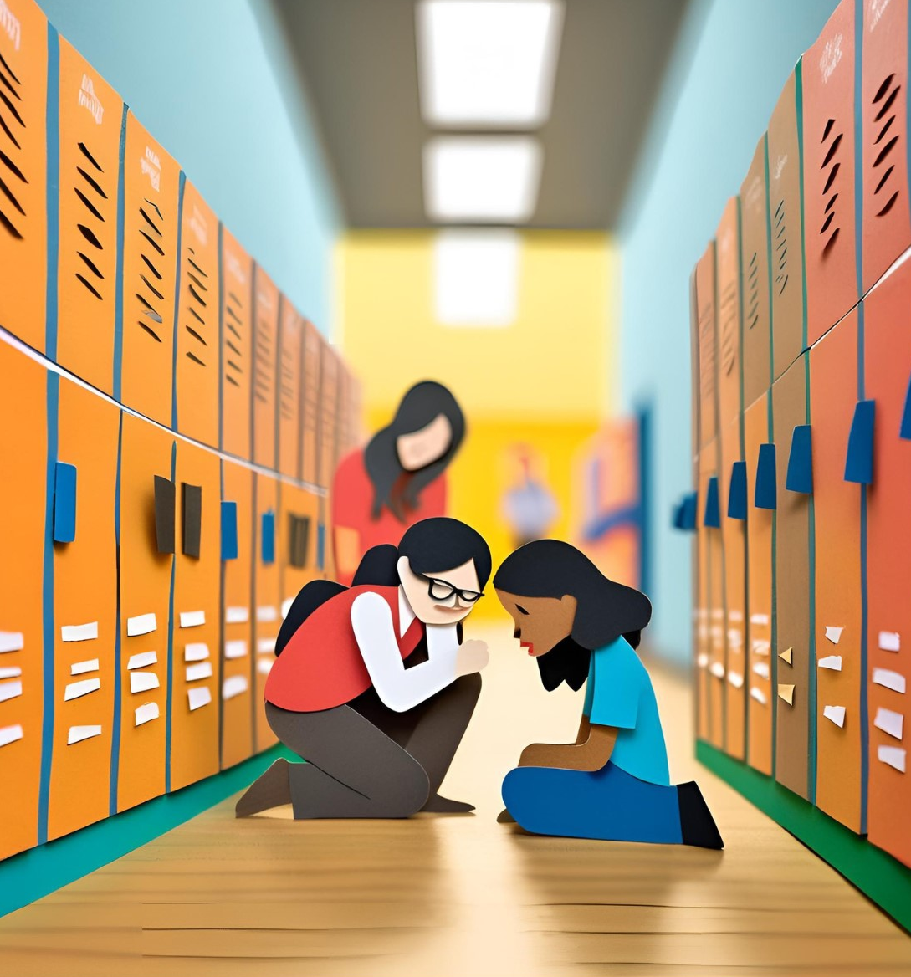
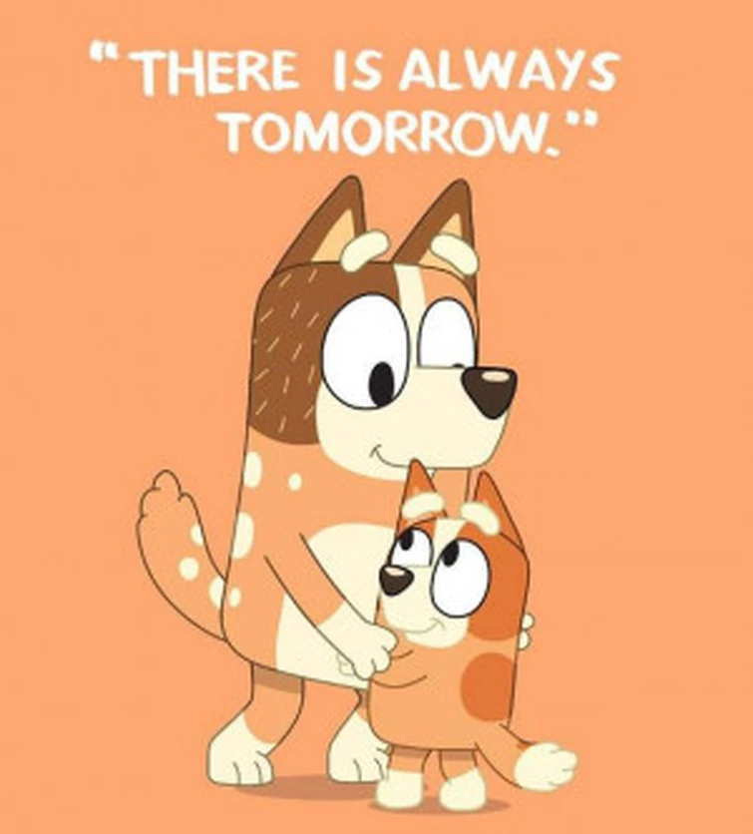
Moving Beyond Discipline:
How to Repair and Rebuild
Notes:
Candace
Pg. 398
Children who are impulsive, oppositional, inattentive and aggressive will need constant teacher monitoring or scaffolding involving redirection, warnings, reminders and consistent follow through with consequences. However, one of the hardest and most important things for the adult to do when working a disruptive student is to move beyond consequences/discipline tools to repair and rebuild the strained adult-student, and student-student, relationships.
This means not holding on to grudges and resentments after consequences have been implemented, welcoming students back as accepted and valued members of the class each day and continuing to teach them more effective ways of problem-solving. It means shifting our mindset and taking on a philosophy of taking one day at a time., allowing the student a new learning opportunity or fresh start each day, and practicing forgiveness. So instead of saying “I hope today isn’t going to be like yesterday because….” try, “I’m so glad to see you!”.

Slide 60
Reflection
Notes:
Candace

Slide 61

Notes:
Candace

