Slide 1


PSS Board Presentation
April 30th, 2025
AUTISM
Notes:
Amanda
Approx. 75 kids in the division with an ASD diagnosis
Targeted EAs for the PD as they are often the front-line workers with some of these students
Will share facts on PSSD psychologist’s role in ASD assessment over the years

Slide 2
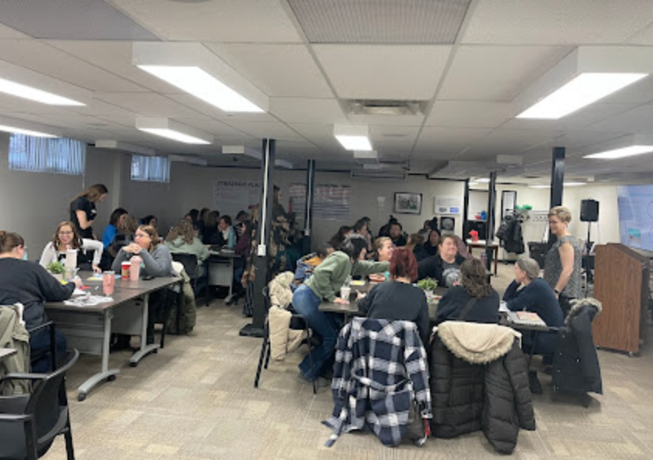
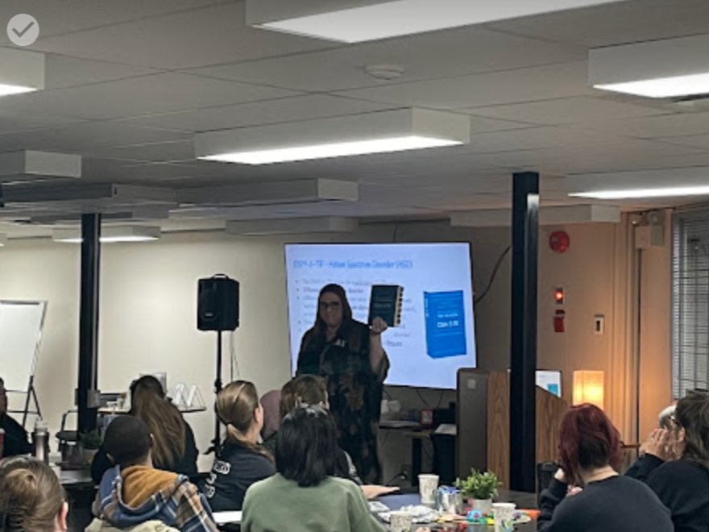
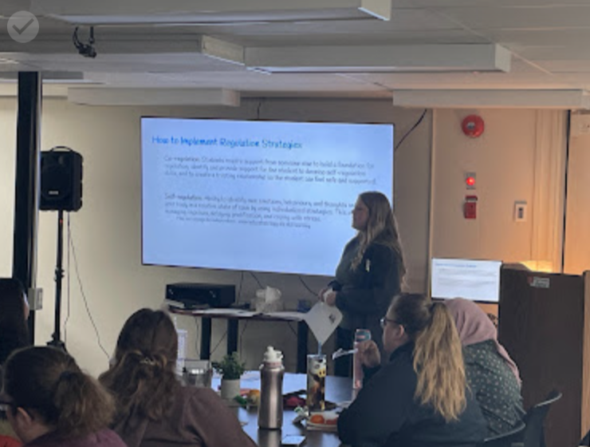
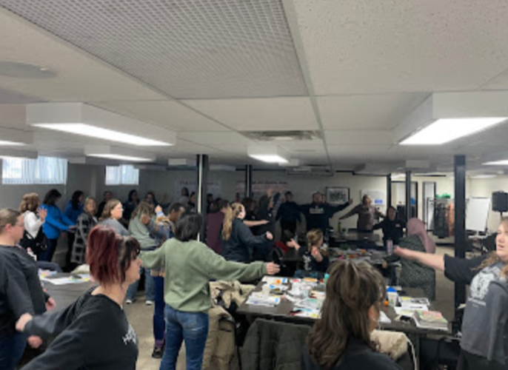
Notes:
Jen
Super proud of the fact that we are able to offer EA’s professional learning opportunities throughout the year.
We asked for feedback last year from EA’s on topics that they wanted to see for this year’s EA PD days and AUTISM was loud and clear
EA PD on January 31st
50 participants
World Autism Month is April
Educational assistants benefit from learning about autism because autistic students have unique ways of thinking, communicating, and experiencing the world. Understanding autism helps EAs provide better support, create an inclusive learning environment, and adapt strategies to meet individual needs. With the right knowledge, EAs can foster positive relationships, reduce barriers to learning, and help autistic students thrive in school.

Slide 3
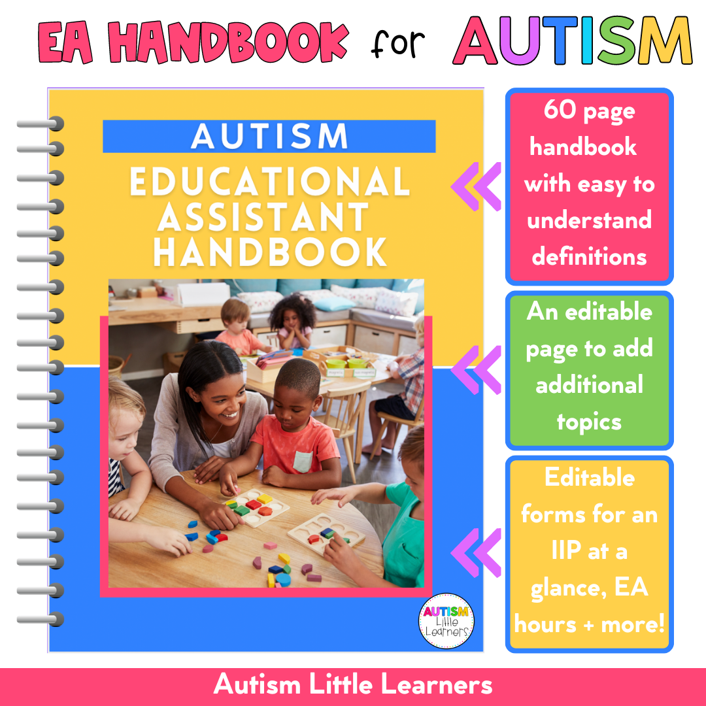
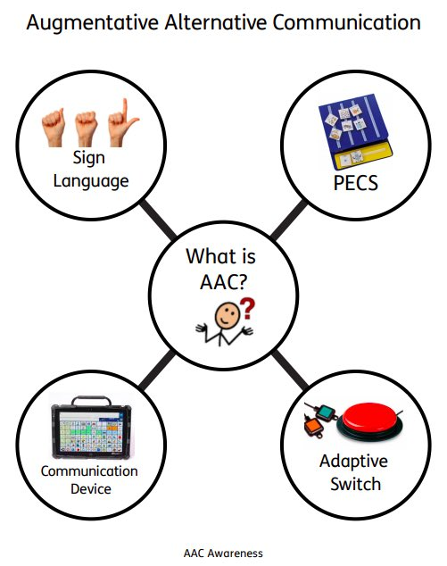
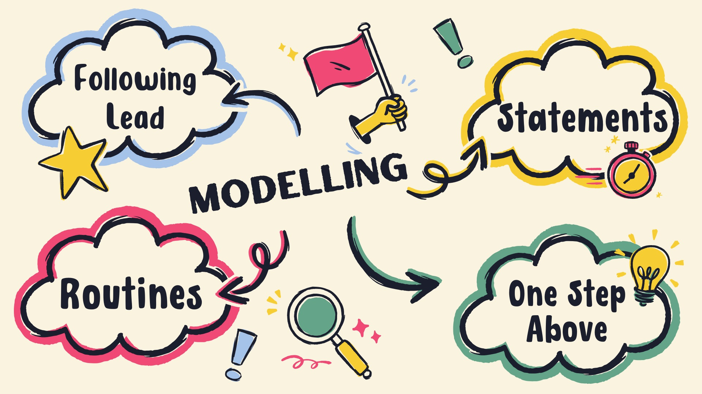
ASD EA PD Summary
Understanding Autism Spectrum Disorder: Diagnostic Criteria
Sensory and Regulation Strategies: Calming and Alerting Strategies, Regulation before Learning, and Identifying Regulation in Students
Communication Methods: Augmentative/Alternative Communication, Modeling, Increasing Language, Statements not Questions, and Visuals
Notes:
Jen
During the PD we covered the following topics and evidence-based strategies. Participants each received the EA Handbook for Autism. First, we discussed the diagnostic criteria and discussed some of the myths about Autism, which we will be doing together today.
Next, we discussed sensory and regulation strategies. Our OT, Shelby, went through calming and alerting strategies and how to identify when students are regulated and ready to learn. She stressed the important point that we must first have our students be regulated before we can expect learning to occur.
Our speech pathologist, Tracy, discussed communication methods stressing the importance of modeling, using wait time, routines, visuals, gestures, statements instead of questions, and stating our directives in the positive (i.e. “walk” instead of “don’t run”). She also overviewed alternative communication methods like sign language, pictures, and technology use which are all valid communication methods.

Slide 4


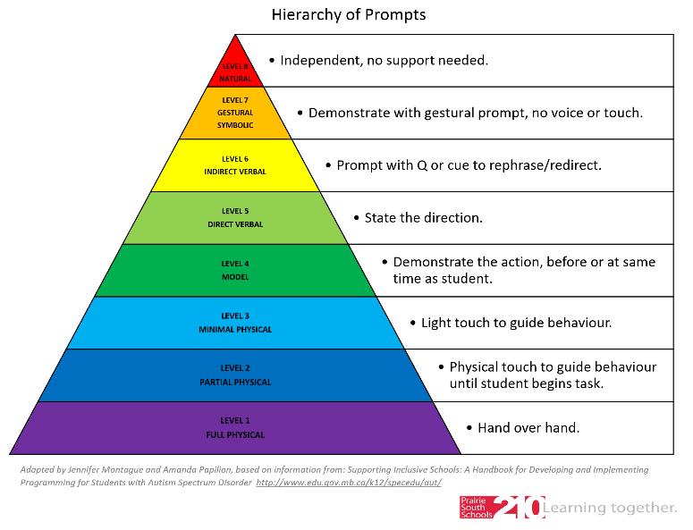
ASD EA PD Summary
Building Relationships: Following the Child’s Lead/Interests
Classroom Strategies: Transitions, Visuals, Wait Time, Prompting, Increasing Independence, Routines, and Expanding Skills
Notes:
Jen
In the afternoon, our early years consultant, Tammy, discussed play and how we can use the child’s interest to build a positive relationship. She highlighted the need to be flexible (i.e. interests can shift day-to-day) and present in our connections.
Amanda, a Student Support Consultant, and Shelby, OT, focused on classroom strategies including supporting transitions with visuals and FIRST/THEN directives, utilizing routines, the prompting hierarchy, and other ways to foster student independence.
The day was quite interactive with opportunities for EAs to share their knowledge and build upon their skillset.

Slide 5
Understanding Autism
Notes:
Kourtney/Bellows

Slide 6
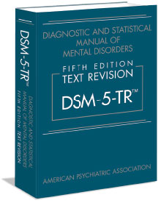
DSM-5-TR - Autism Spectrum Disorder (ASD)
The DSM-5-TR allows for a wide range of difference.
Difference does not mean disorder.
Difference becomes a disorder when it is clinically significant and the person is in “significant distress in social, [educational], or other important activities” (DSM-5-TR, 2022, p. 20).
Disorder means that the person's functioning is impaired.
There is no such thing as “high functioning ____ disorder.” However, a person may be doing well because they are supported.
Notes:
Kourtney/Bellows
The DSM-5-TR sets the parameters for meeting or not meeting a diagnosis of ASD. A psychologist, psychiatrist, or pediatrician makes the diagnosis.
The DSM-5-TR allows for a wide range of difference. Difference does not mean disorder.
Difference becomes a disorder when it is clinically significant and the person is in “significant distress in social, [educational], or other important activities.”
“A mental disorder is a syndrome characterized by clinically significant disturbance in an individual’s cognition, emotion regulation, or behaviour that reflects a dysfunction in the psychological, biological, or developmental processes underlying mental functioning… significant distress or disability in social, occupational, or other important activities” (DSM-5, 2022, p. 20).
Ex) medication-induced movement disorder, being part of a gang, being quirky/unique, suffering grief after a loss is NOT a disorder
Disorder means that functioning is impaired.
There is no such thing as high functioning ASD or high functioning ADHD or high functioning Anxiety, etc. People may be doing well because they are supported. This is a great argument as to why we keep supporting individuals once they are doing better.
Other: ASD encompasses autistic disorder, Asperger’s, and childhood disintegrative disorder. It is characterized by deficits in social communication/interaction AND restricted/repetitive patterns of behaviour/interests/activities.

Slide 7
DSM-5-TR - Autism Spectrum Disorder (ASD)
Criteria A | Criteria B
Persistent deficits in social communication and social interaction across multiple contexts including: Social-emotional reciprocity Non-verbal behaviours Understanding and developing relationships | Restricted, repetitive patterns of behaviour, interests, or activities (need 2 or more): Stereotyped or repetitive motor movements, use of objects, or speech Inflexible adherence to routine Restricted fixated interests Hyper or hypoactivity to sensory input
AND
Prevalence: 1% of the population.
Ratio Male to Female: 4:1
Notes:
Kourtney/Bellows
Criteria: Persistent deficits in social communication and social interaction across multiple contexts ex) social-emotional reciprocity, nonverbal behaviours, understanding and developing relationships. AND Restricted, repetitive patterns of behavior, interests, or activities as manifest by at least 2: stereotyped or repetitive motor movements, use of objects or speech, inflexible adherence to routines, restricted fixated interests, hyper or hypoactivity to sensory input.
IT IS BOTH - i.e. I have an inflexible adherence to routine, but I do not meet criteria. Again, difference is not disorder. We all have specific interests; that isn’t a disorder.
It is also ALL - you need to have evidence of all of criteria A and at least 2 from criteria B. Meeting an item or 2, does not mean you have the diagnosis. There is also no such thing as “close to diagnosis” - you have it or you don’t.

Slide 8

DSM-5-TR - Autism Spectrum Disorder (ASD)
Turn and Talk…
Did any of the diagnostic criteria surprise you?
Does the 1% prevalence rate seem accurate?
What is “missing” from the diagnostic criteria that you were expecting to see?
Notes:
Kourtney/Bellows
Activity: Turn and chat to partner then share with group.
Debrief:
What is missing from the diagnostic criteria that you were expecting? I.e. eye contact isn’t in the criteria, etc.
Prevalence rate: common search on Google (i.e. new mom); our jobs; not institutionalized, better awareness, financial support, etc.
Note: go back to the diagnostic criteria so people can reference the slide when discussing these questions!

Slide 9
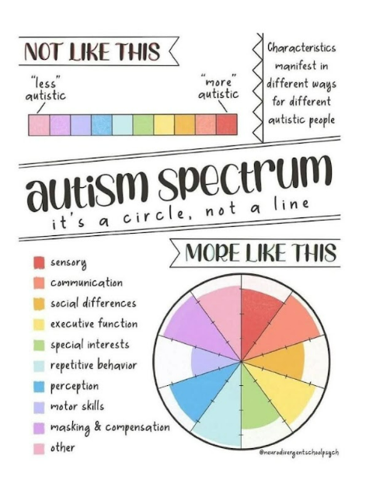
DSM-5-TR - Autism Spectrum Disorder (ASD)
A note on severity levels…
Severity levels are based on the level of support.
All people still need support.
Severity levels have nothing to do with functioning.
Functioning is not universal across all skills and environments - we all have strengths and weaknesses.
Notes:
Kourtney/Bellows
Severity is based on level of support for both criteria. Level 1 – support; Level 2 – substantial support; Level 3 – very substantial support.
Functioning is broad - how you function at work, in the kitchen, at a social gathering, etc. There isn’t universal functioning for each skill and environment at life as we all have strengths and weaknesses.
Remember: to meet criteria for ASD (and any other mental health disorder), the person must have functional impairment. In other words, there is no such thing as “high functioning ASD.”

Slide 10
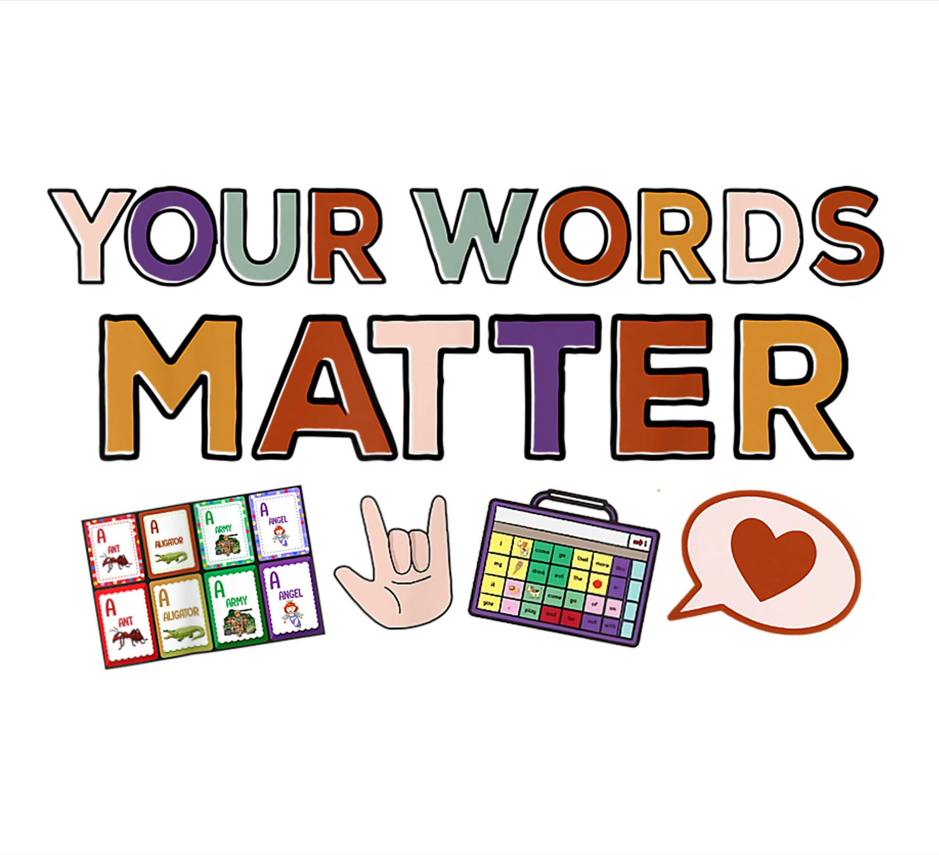

DSM-5-TR - Autism Spectrum Disorder (ASD)
A note on our language…
We should not be using terms like “high functioning” or “low functioning ASD.”
However, using identity-first language vs. people-first language is a case-by-case situation.
Some disability self-advocates prefer identity-first language (i.e. Autistic person).
If you are unsure as to whether you should use people-first or identity-first language in order to be respectful, the best thing to do is ask the people themselves.
Notes:
Kourtney/Bellows
While we shouldn’t be using terms like “high-functioning” or “low-functioning ASD” it is case-by-case for identify-first or people-first language.
The Association of University Centers on Disabilities (AUCD) notes that “some disability self-advocates prefer identity-first language (i.e. Autistic person). Identity-first language emphasizes that the disability plays a role in who the person is, and reinforces disability as a positive cultural identifier… it is important to note that whether a person with a disability prefers people-first or identity-first language it is not universal.
People first language is name first then “with autism.”
ASK if you are unsure. I still start with people-first as it may be the first time they are given the diagnosis and it is young children that we work with.

Slide 11
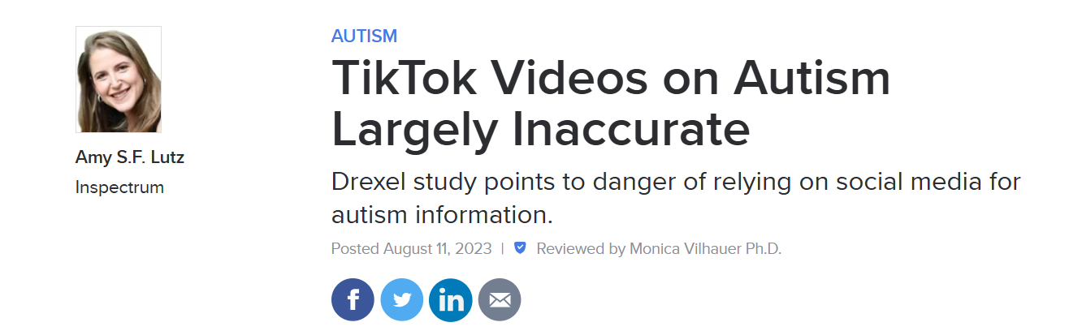

DSM-5-TR - Autism Spectrum Disorder (ASD)
A note on sources of information…
“Over 70% of the information about ASD and other diagnoses on TikTok and other social media platforms is inaccurate.” - Psychology Today, 2023
Notes:
Kourtney/Bellows
A note on this section: This is simplified from the DSM-5-TR. Please know that it is a complex process to diagnose an individual.
Also, a 2023 Psychology Today research study showed that “more than 70% of autism information on TikTok is inaccurate, according to a new study.”
Ex. Take this IQ test or download this APP to improve your IQ. AuDHD, PDA, etc.
I follow this lady on Facebook that basically retells funny stories from her life. She was saying how she “is honest so she must have Autism?” Most of the comments were either saying yes, or trauma, or throwing in Narcissism for fun. While I can’t tell you if she has Autism or not - honesty is not a diagnostic factor and in fact is a pretty universal trait.
Bent wrist under pillow = ADHD TikTok video.
Our sources should be psychologists with APE, psychiatrists, etc.

Slide 12
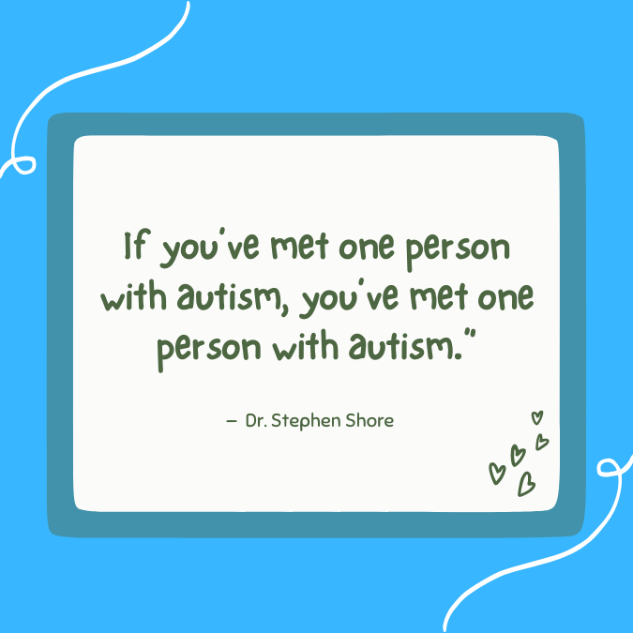
Notes:
Kourtney/Bellows
This quote always makes me laugh because…
We are all different - or unique. And we all have our own challenges and strengths. This is the same for anyone on the spectrum.
For instance, if you’ve met me, a pregnant woman, you’ve met one pregnant woman. If you’ve met one Ukrainian, you’ve met one Ukrainian. If you’ve met one boy, you’ve met one boy.
So, it is self-explanatory that if you’ve met one person with autism, you’ve met one autistic person.

Slide 13
Autism Myths Group Activity
With your partner, decide if the statement is a MYTH or a FACT.
What information do you know to support your claim?
Pick one person to share back to the larger group.
Notes:
Jen

Slide 14

Notes:
Jen - Testimonial (Mark - EAL/ASD parent)
This is a testimonial from one of our parents whose children have an ASD diagnosis and are EAL learners. He highlights why we do this important work and why Prairie South Schools is a great place to learn and work!

Slide 15

Notes:
Jen

