Slide 1
ASD
Masking
LD Meeting
April 11th, 2025

Slide 2
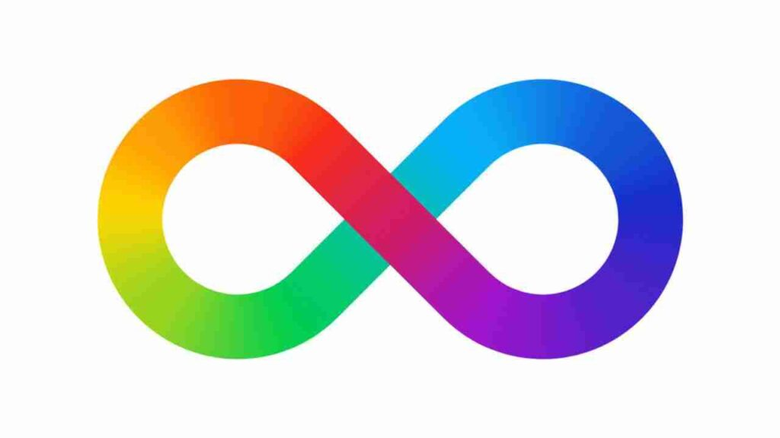
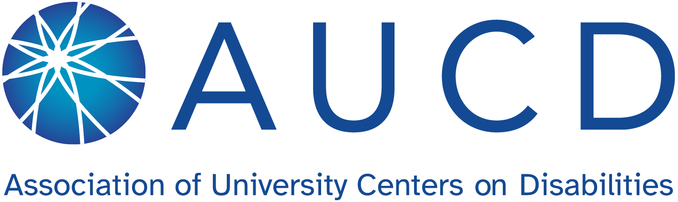
DisclosureS ³
Diagnosing ASD is a complex process and a competency area that I’m still in the process of developing.
I have a healthy skepticism of the masking phenomenon due to the available research.
I will be using identity-first (i.e. “Autistic person”) rather than person-first language as typically preferred by the Autistic community.
Notes:
I have been asked to provide an overview of masking. I do want to be honest that I’m skeptical of this concept due to the research around it. I did try to keep an open mind and research valid sources (which are all noted in the subscripts on the slides).
Additionally, differential diagnosis of ASD is complex - something I’m still learning and couldn’t begin to teach you in 30 minutes.
The slides are information heavy but I have tried to simplify the concepts to make it more conversational. Please ask questions as needed.
I will be using identity-first language (i.e. Autistic person) as per recent guideline changes.
Source: #3 The Association of University Centers on Disabilities (AUCD) - notes that “some disability self-advocates prefer identity-first language. Identity-first language emphasizes that the disability plays a role in who the person is, and reinforces disability as a positive cultural identifier… it is important to note that whether a person with a disability prefers people-first or identity-first language it is not universal.

Slide 3
Questions to be Discussed
What is the diagnostic criteria for ASD?
What is masking?
What are the benefits and risks of masking?
What are some highlights of the research on masking?
Is masking ASD-specific?
Is masking a diagnostic term?
What are the future implications for interventions?

Slide 4
Question 1:
What is the DSM-5-TR Diagnostic Criteria for ASD?

Slide 5
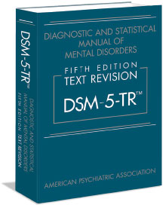
What is ASD? ²
Criteria A | Criteria B
Persistent deficits in social communication and social interaction across multiple contexts including: Social-emotional reciprocity Non-verbal behaviours Understanding and developing relationships | Restricted, repetitive patterns of behaviour, interests, or activities (need 2 or more): Stereotyped or repetitive motor movements, use of objects, or speech Inflexible adherence to routine Restricted fixated interests Hyper or hypoactivity to sensory input
AND
→ Prevalence: 1% of the population.
→ Ratio Male to Female: 4:1
Notes:
Source: DSM-5-TR #2
Criteria: Persistent deficits in social communication and social interaction across multiple contexts ex) social-emotional reciprocity, nonverbal behaviours, understanding and developing relationships. AND Restricted, repetitive patterns of behavior, interests, or activities as manifest by at least 2: stereotyped or repetitive motor movements, use of objects or speech, inflexible adherence to routines, restricted fixated interests, hyper or hypoactivity to sensory input.
IT IS BOTH - i.e. I have an inflexible adherence to routine, but I do not meet criteria. Why? Difference is not disorder. We all have specific interests; that isn’t a disorder on its own.
It is also ALL - you need to have evidence of all of criteria A and at least 2 from criteria B. Meeting an item or 2, does not mean you have the diagnosis.
There is also no such thing as “close to diagnosis” - you have it or you don’t.
Prevalence male to female is 4:1 - and we will be looking at that today so keep that in mind.
The DSM-5-TR allows for a wide range of difference.
All neurodevelopmental disorders and many without a disorder struggle with social communication and interaction.
Take away: difference is not disorder.

Slide 6
Question 2 and 3:
What is masking and What are the Benefits and Risks of Masking?

Slide 7
What is Masking? ^{1, 9}
Autistic Masking (also called camouflaging) is a phenomenon where autistic individuals consciously or unconsciously conceal autistic traits to fit neurotypical social norms. It can include suppressing autistic behaviours or adopting neurotypical behaviours:
→ hiding stimming behaviours and/or sensory discomfort
→ forcing eye contact
→ pretending to follow along or be interested in conversations
→ hiding or minimizing interests
→ mimicking neurotypical social interactions (i.e. facial expressions and/or gestures)
→ relying heavily on communication scripts, etc.
Notes:
Source: Understanding Autism Masking and Its Consequences #9 and #1
Communication script: “How are you?” “Good.” or “What about that weather?”
Elicit AI: Masking is defined as the “deliberate concealment or compensation of autism features in social contexts.”

Slide 8
Benefits and Risks of masking
Benefits ^{1, 4, 9, 10, 11, 12, 16} | Risks 1, 4, 9, 10, 11, 12, 13, 16, 21, 22, 25, 26
Avoiding stigma, exclusion, and bullying Increasing social acceptance Achieving employment and other goals Feeling successful in brief social interactions | Mental health impacts (i.e. anxiety, stress, depression, suicidal ideation, etc.) Physical health impacts (i.e. exhaustion) Acceptance concerns (i.e. feeling inauthentic and lonely) Lack of supports and diagnosis
Notes:
Often moderate findings re risks - more research is required.
Sources:
Understanding Autism Masking and Its Consequences #9
ASD in Females with Masking #10
ASD Camo. in Adults #1
ASD Masking in Adults in Social Settings #11
ASD Masking and MH in Teens #4 - “Autistic people who mask more also report higher levels of anxiety (Cage & Troxell-Whitman, 2019; Hull, Levy et al., 2021; Livingston, Shah, & Happé, 2019), and some studies have also found an association between masking and depression (Cage et al., 2018; Hull, Levy et al., 2021).”
ASD Masking at Work #16
ASD Masking Time to Stop #12
Also sources #1, 13, 21, 22, 25, and 26 from Elicit AI article - moderate effect size - more research required re risks/impact

Slide 9
Question 4:
What are some highlights of the Research on Masking?

Slide 10
Masking in the research ^{1, 4, 7, 8, 10, 11, 13, 17, 19}
Masking research is within the first 5+ years.
There are few meta-analyses and peer reviewed research studies on the topic.
The available information includes personal anecdotes (i.e. lived experiences of autistic adults).
There are some qualitative studies done with autistic adults or their caregivers being interviewed retrospectively via semi-structured interviews or online questionnaires. Researchers then try to determine themes (thematic mapping).
The questionnaires are usually not standardized or shared, impacting study replication.
Notes:
I have 27 resources that I reviewed. Elicit AI (which is for research) noted that there are up to 50 articles on the topic. However, when I filtered with sound research criteria, only 10 studies were acceptable (and honestly a couple of those weren’t great). Therefore, there is around 10 or less sound research studies on the topic of masking with ASD based on my search. The studies were from 2017-2024.
There was 1 meta-analysis (source #22), 3 systematic reviews (source #20, 1, and 24), 4 observational studies (3 cross-sectional) (sources #13, 25, 26, and 27), 1 mixed methods (source # 23), and 1 narrative study (source #21).
Only studies #26, 23, and 20 used children - 2 being sound studies (#26 and #20). #22, #24, #13, and #25 had mixed populations with some children included.
I won’t go into full blown stats and research lesson here but we are going to touch on elements that make research sound and I’ll review the articles that didn’t make the cut.
I finished my masters in 2021 and we did not discuss masking.
Sources:
ASD Masking - only last 5 years #17
ASD Camo. in Adults #1
Qualitative Studies:
ASD Identification in Girls - interviews #8
ASD Masking Takes 2 - online form #7
ASD Masking in Adults in Social Settings - questionnaire #11
ASD and Social Masking in Girls - semi-structured interview #19
ASD in Females with Masking - interviewed the moms #10
ASD Masking and MH in Teens #4
Masking is Life - thematic mapping #13

Slide 11
Masking in the research ^{1, 17, 24}
Some studies use the self-reported Camouflage Autistic Traits Questionnaire (CAT-Q). However, preliminary studies show that the CAT-Q has high correlations with social anxiety measures. Furthermore, the questionnaire has failed to differentiate between autistic and non-autistic participants, sometimes showing higher scores in the control group (i.e. issues with convergent and divergent validity).
The term “masking” itself has not been operationally defined impacting construct validity. Studies may actually be measuring ADHD or anxiety symptomatology, social oppression, coping strategies, or results of a social skills intervention.
Notes:
Some studies use CAT-Q which is good for replication but the tool itself has issues with convergent and divergent validity. Basically, if I’m making a depression scale and half of you are really depressed and the other half are not, I want this group NOT to endorse the depression questions/items and the depressed group to endorse them so that the groups diverge. Within-group we want you to converge.
Construct validity - are you measuring what you say you are measuring.
From Elicit AI article: some called it “disguising autism features” or “presenting a non-autistic social style,” or “minimizing visibility of autism.”
Overall, the term masking needs more conceptual clarity and a clear differentiation between feelings, experiences, cognitive processing, behaviors, and the real-life social predicament of autistic people.
Sources:
ASD Camo. in Adults #1
ASD Masking #17 - only last 5 years; masking not operationally defined;
Issues with Questionnaire-Based Measures: Alternative approaches using ad hoc questionnaires like the Camouflage Autistic Traits Questionnaire (CAT-Q) also have limitations. Preliminary studies showed high correlations with social anxiety measures, suggesting a confounding of camouflage with co-occurring anxiety .These confounding effects were often ignored in subsequent analyses. Subscales within these questionnaires, such as the masking subscale of the CAT-Q, have failed to reliably differentiate between autistic and non-autistic participants, sometimes even showing higher scores in controls. Testing other compensation checklists has also yielded weak or inconsistent results in differentiating autistic and non-autistic individuals.
Lack of Conceptual Clarity and Construct Validity: Overall, camouflage measures are considered to be in their infancy and lack demonstrated fundamental properties, especially construct validity (whether they truly measure what they intend to measure). There's a need for more conceptual clarity and a clear differentiation between feelings, experiences, cognitive processing, behaviors, and the real-life social predicament of autistic people.
Conflation with Social Skills and Coping Strategies: Camouflage might be better understood as one of several coping and adaptive strategies autistic individuals use to adjust to their social environment, alongside other non-camouflaging behaviors . Many of the behaviors discussed as camouflage (e.g., maintaining eye contact, using scripted language) are also targets of social skills interventions, raising questions about whether "camouflage research" represents a truly new area of investigation.
From Elicit AI article: some called it “disguising autism features” or “presenting a non-autistic social style,” or “minimizing visibility of autism.”

Slide 12
Masking in the research ^{1, 17, 24}
The studies typically do not involve a comparison group.
The norm groups used typically do not represent the population (i.e. US population or the full spectrum of autistic individuals) as studies often have small sample sizes formed without standard sampling methods.
The studies with comparison groups use a discrepancy approach comparing self-reported autism scores with professional observations using the ADOS. However, self-reported scores often have low validity and the ADOS was not created to capture masking behaviour, again impacting construct validity.
Notes:
Comparison/control/norm group issues
Crucially, no study using the discrepancy approach has independently demonstrated that the resulting score truly measures camouflage. Correlations with external criteria do not establish construct validity.
Sources:
ASD Camo. in Adults #1
ASD Masking #17 - only last 5 years; masking not operationally defined;
Variability in Operationalization: Studies have used variable approaches to define and measure camouflage . One common method, the "discrepancy approach," which compares self-reported autism scores with professional observations (like ADOS scores), faces several serious problems. There's little evidence that self-reported autism scores are the most valid measure of autism, nor that a brief ADOS session adequately captures camouflaged behavior. Statistically, the difference between two scores measuring the same underlying construct is likely another index of that construct, not necessarily a measure of a new construct like camouflaging. The "ideal body weight" vs. "actual body weight" analogy illustrates this point. Using a multitrait multimethod paradigm makes it difficult to separate true scores from measurement errors. Crucially, no study using the discrepancy approach has independently demonstrated that the resulting score truly measures camouflage. Correlations with external criteria do not establish construct validity.
Construct validity - are you measuring what you are supposed to measure
Sampling methods - simple random sampling, systematic sample, stratified or cluster.

Slide 13
Research kids/youth 1, 4, ,8, 10, 11, 18, 19, 20, 22, 23, 24, 26, 27
The concept of masking stems from the theory of the female autism phenotype (FAP) (i.e. biological factors impact the presentation of ASD symptomatology in females). This theory has yet to be proven or disproven.
Masking research has primarily focused on adult women with higher IQs.
There have been few robust studies or otherwise on masking in children and adolescents (only 2 sound studies).
Yet, masking is being discussed as something that begins in childhood despite a lack of research or anecdotal reports on the topic.
Notes:
Masking studies have also left out non-verbal individuals, those with lower IQs, children/youth, males, etc.
Female Autism Phenotype: 4:1 prevalence.
Sources:
ASD Camo Cost #18
ASD and Social Masking Strategies in Girls #19
ASD, Masking, and MH in Teens #4
ASD Identification in Girls #8
ASD Masking in Adults in Social Settings #11 - successful masking might indicate a lack of significant underlying issues requiring diagnosis.
ASD in Females with Masking #10 - “One limitation of the current masking literature is its focus on adults, with few studies conducted with autistic young people (Cook, Hull, Crane & Mandy, 2021)”
Female Autism Phenotype (FAP): This review paper examines the underdiagnosis of autism spectrum disorder (ASD) in females. It explores the concept of a female autism phenotype (FAP), suggesting that autistic traits may manifest differently in females than the traditionally male-centric diagnostic criteria reflect. A key focus is on camouflaging, where autistic individuals, particularly females, consciously or unconsciously mask their autistic characteristics in social situations. The authors discuss the female protective effect theory as a potential biological factor influencing ASD development in females, while also highlighting how diagnostic biases and the unique presentation of autism in females contribute to underdiagnosis. Ultimately, the paper emphasizes the need for further research into the FAP and camouflaging to improve the identification and support of autistic females.
From Elicit AI articles sources 1, 22, and 26 note that females may not meet criteria due to similar impairments because of masking. The tools are lacking and overlook female presentations of ASD and delayed diagnosis is common in this population.

Slide 14
Research issues summary
Newer research topic.
10 or less sound studies (only 1 being a meta-analysis)
Studies are not representative of the full ASD spectrum or the population due to the sampling methods used.
There are few studies with children/youth (only 2 sound studies).
The tools used and study replication are both limited.
There are issues with convergent, divergent, and construct validity.
Notes:
Summary: new research topic with few available studies, especially on youth/children and the full spectrum. Studies have been completed with high IQ adult women without standard sampling methods (small sample sizes). Study replication and meta-analyses are sparse. There are convergent, divergent, and construct validity issues.

Slide 15
Question 5:
Is masking ASD-Specific?

Slide 16

Is masking asd-specific? ^{13, 16, 25}
Within the autistic community, masking is said to be ASD-specific.
However, there is a body of research (i.e. research on other neurodevelopmental disorders, sociology studies, workplace behaviour studies, etc.) that support the idea that masking is universal.
The difference may be the amount of effort that it takes or the motivations to mask.
Notes:
When I went to NY in 2019, my husband and I quickly realized that the social norm on the subway train was to not make eye contact and chit-chat. Obviously, this is juxtaposition with our culture coming from Saskatchewan where we smile at others, hold open doors, and ask about the weather. However, we quickly blended in with our surroundings - effectively masking. We do this when we go to eat at someone else’s house, when we are at work, etc.
Many of you are masking right now - listening to me only because you have to, have a mortgage to pay, socially don’t want to stand out, maybe because you like me or feel bad for me, etc. But all of you don’t want to hear this right now, yet are listening or attempting to appear like you are listening. This has been studied in workplace behaviour studies and there is a definite benefit to it (aka not full-on anarchy, no one is throwing a chair at me, rude comments are being suppressed, we can get things accomplished, etc.).
You can think about ‘home you’ vs ‘work you.’ If you are more introverted you likely know all about masking. And introverted or not, we all have suppressed certain aspects of ourselves, chose not to share things, maybe started saying a phrase to fit in with the group, etc. (go observe any middle years classroom).
Sociology studies have shown that people often attempt to present themselves in ways that are acceptable to others, even if it is to the detriment of their own well-being (self-image studies).
Overall, there is mixed to moderate evidence that it is ASD-specific to mask (issues with construct validity and it not being operationally defined). Some aspects, like hiding stimming, may be ASD-specific but other things are shared across all individuals and those with diagnosed social anxiety. From Elicit AI: “Masking occurs strongly in autistic populations with some unique features, though it overlaps with broader social adaptation strategies used by non-autistic individuals.”
The effort required and motivations to mask may be different or more taxing for those with ASD.
Video (1 min): Here is a workplace example from Kaelynn an Autistic woman. You can see how complex social behaviour and communication is.
Sources:
ASD Masking at Work #16 and Masking is Life #13:
Masking is not exclusive to autism: The sources emphasize that masking or similar forms of social adaptation and impression management are not unique to autistic individuals. Non-autistic people also engage in behaviors to fit in, manage social situations, and avoid negative perceptions. They might conceal aspects of their personality, adopt certain behaviors to be accepted in a group, or present a specific image in professional settings.
Shared masking strategies: Some masking strategies, such as mimicking others' behaviors, using rehearsed phrases, and suppressing certain traits, can be employed by both autistic and non-autistic individuals for social response.
General Social Practice: Many neurotypical people manage how others perceive them in social situations. People often attempt to present themselves in ways that are acceptable to others, even if it is to the detriment of their own well-being. This aligns with sociological research on presenting a desired self-image.
Workplace Masking: Research specifically examining workplace masking found that masking strategies are widely employed by neurodivergent and neurotypical employees. Neurotypical participants in one study reported being "more careful" in how they present themselves at work and described masking as "always playing a part, pretending to be neurotypical.” This suggests that even neurotypical individuals feel pressure to conform to workplace norms. They may mask to maintain relationships with colleagues or during initial interactions, and to avoid negative judgements from colleagues and employers.
All individuals have reported the exhaustion of masking or stigma-management/trying to fit in.
Effort and Identity: While neurotypical individuals engage in impression management, research suggests that camouflaging by autistic individuals is often reported as extremely effortful and challenging to one’s identity, unlike ordinary reputation management in typically developing individuals. Autistic and non-autistic neurodivergent participants reported unique challenges in suppressing stimming behaviors and sensory sensitivities at work.
In conclusion, while the term "masking" is often discussed in the context of autism, the sources indicate that it is a broader human experience. Non-autistic individuals also mask to manage social interactions, fit into social and professional environments, and avoid negative perceptions. However, the intensity, specific motivations (such as concealing autistic traits), and the experienced cost (like sensory suppression and potential for autistic burnout) may differ for autistic individuals.
Sources #13 and 25 from Elicit AI article: mixed to moderate evidence that it is ASD-specific to mask. Some aspects, like hiding stimming, may be ASD-specific but other things are shared across all individuals and it may be social anxiety.

Slide 17
Question 6: Is masking A diagnostic term?

Slide 18
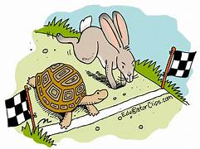
Masking in the DSM-5-TR 1, 4, 6, 7, 10, 12, 14, 15, 22, 26
While masking may make it more difficult to accurately diagnose ASD, it is currently not in the diagnostic criteria… and psychologists move slowly while internet self-diagnosis does not.
“More than 70% of the autism information [on] TikTok is unreliable.” - Psychology Today, 2023
Notes:
Source #20: Studies so far have not proven that masking means a more severe presentation of ASD. Masking is not a diagnostic term or criteria.
The concept of masking complicates diagnosis. Basically, you could say someone doesn’t meet A criteria and then they could say they were just masking. It calls into question impairment because in order to have a diagnosis of any kind, there must be functional impairment across environments. So what is the threshold for ASD?
Additionally, we do not have many diagnostic tools to use to explore camouflaging and there is no indication when or if masking would become part of the diagnostic criteria in future versions of the DSM.
The concept is further convoluted when you consider that masking is said to be conscious and unconscious. This has not been studied. It’s almost exclusively high IQ adult women who can discuss their internal thoughts and processes. How would you do this for a non-verbal individual on the spectrum?
Since masking appears to be a learned behaviour there should still be evidence of historical issues with social communication and interaction (A criteria) and the RBBIs (B criteria).
Psychologists and researchers move slow - for instance, gaming addiction isn’t even a disorder yet and technology has been around in this way for about 15+ years. However, online self-diagnosis and TikTok videos move fast! It is important to note that over 70% of the diagnostic information found on social media is false (Psychology Today, 2023).
Psychologists = tortoise. Society = hare. (Note: “slow and steady wins the race.”).
At this point, psychologists can increase our awareness of masking, be open to new information, focus on internal experiences not just what we can observe externally, have multiple informants, engage in longitudinal assessment, and work on developing tools to measure masking (i.e. Camouflaging Autistic Traits Questionnaire (CAT-Q)).
Sources:
ASD Masking in Girls at School #6
ASD in Females with Masking #10
Analysis of ASD Masking #15
Masking Time to Stop #12
ASD Camo #1
ASD Masking Takes 2 #7
ASD Masking and MH in Teens #4 - higher age/cognitive ability and verbal
Influence of online information and self-diagnosis: With increased awareness of autism and the concept of masking online, individuals might identify with descriptions of masking behaviors based on general social difficulties or personality traits without having a comprehensive understanding of ASD diagnostic criteria. This could lead to a belief that they are masking autistic traits when they are not.
Impact on Diagnosis: Masking can make it more difficult to accurately diagnose autism, particularly in individuals who learn to camouflage their traits effectively. Clinicians may miss underlying autistic characteristics during assessments because the individual is actively masking. This is particularly noted in the context of underdiagnosis in women and girls. The discrepancy between an individual's internal experience and their outward presentation due to masking can lead to individuals appearing "close to the threshold for a diagnosis of autism" being missed.
Underlying Social Communication Differences Remain: Even when an autistic person successfully masks, the fundamental differences in social information processing and communication styles as described in Criterion A of the DSM-5-TR are still present. Masking is a surface-level adaptation, not a change in the underlying neurology or social cognitive processing . An individual might learn to make eye contact or use conversational scripts, but this doesn't necessarily mean they experience social interaction in the same way as a neurotypical person or that they don't still struggle with social reciprocity, understanding non-verbal cues, or forming and maintaining relationships authentically.
Learned behaviour - should still have historical information on social challenges
Development and Validation of Masking Measures: "Camouflage Autistic Traits Questionnaire total score (CAT-Q; Hull et al., 2019)" and discusses research examining its validity and potential confounding factors. The development of such questionnaires signifies an attempt to quantify and study masking empirically. Hull et al. (2019) in relation to the CAT-Q. - in ASD Camo and ASD Masking Takes 2
As per Elicit AI article source #20 - mixed reviews if higher autistic traits = more masking.

Slide 19
Question 7: what are the future implications for interventions?

Slide 20
Intervention Implications ^{1, 4, 5, 7, 10, 17}
Some autistic advocates are against ABA therapies, social skills training like PEERS, and traditional speech-therapy methods, instead advocating for neurodiversity-affirming approaches.
They call for a shift towards “autistic spaces” where masking is not necessary.
Others argue that the above traditional intervention methods are still appropriate if there is an emphasis on self-advocacy, inclusion, and authentic engagement.
Notes:
Traditional therapies are often viewed as non-neurodiversity-affirming with some basically arguing that any intervention isn’t inclusive. For instance, social skills training my teach social scripts or how to make eye contact which can be considered masking.
Some go as far to say that they should be able to make inappropriate or racist comments otherwise they are being forced to mask and not be themselves - i.e. elon Musk, Kanye West, etc.
Others argue that those methods are still valid as long as we teach the Autistic individual about self-advocacy, have opportunities for authentic engagement, and overall have the goal of inclusion in mind. These people argue that masking should be directly discussed and taught.
Within the Autistic community they are torn between is masking adaptive or not? Is it a tool or social oppression? Are they being integrated into community or just changing who they are? Is it their choice to mask or are they expected to mask? (i.e. some autistic individuals want us to erase any intervention where there may be an emphasis on masking and others want us to teach masking as a coping strategy or compensatory strategy).
Intervention means to improve the course/help. It is synonymous with teaching.
Sources:
ASD Masking and Trauma #5
ASD Camo. #1
ASD Masking Takes 2 #7
ASD Masking and MH in Teens #4
ASD Masking #17
ASD in Females with Masking #10 - may be okay to do social skills training if authentic engagement and self-advocacy
Social Skills Training Can Promote Masking: One source explicitly states that behaviors discussed in camouflage commentaries are precisely those skills actively targeted for scaffolding in social skill treatment interventions . While not suggesting these interventions be renamed "camouflaging boot camps," this highlights the potential overlap between what is taught in social skills training (e.g., maintaining eye contact, using scripted language) and the techniques used for masking.
Potential for Increased Internalized Stigma and Reduced Authenticity: If ABA or social skills training focuses on suppressing autistic traits without addressing the reasons behind them or validating the autistic experience, it could lead to increased internalized stigma, a reduced sense of self and authenticity, and the feeling of having to "act" or "play a role.” This contradicts the idea of fostering well-being and self-acceptance
Focus on External Appearance Over Internal Experience: Traditional approaches might focus on outward behavioral changes (e.g., reducing stimming) without considering the internal function of these behaviors for the autistic individual (e.g., self-regulation, sensory processing). This can lead to the suppression of coping mechanisms and increased internal distress.
Limited Evidence for Long-Term Well-being from Traditional Social Skills Training: One study in "ASD, Masking, and Mental Health in Teens.pdf" suggests that social skills training programmes do not achieve their aim of improving wellbeing by teaching young people the skills to form meaningful friendships and might even inhibit authenticity and increase stigma.
Call for Neurodiversity-Affirming Approaches: The sources advocate for social acceptance in the absence of masking and emphasize the importance of autism acceptance training for non-autistic people to reduce biases. This suggests that the focus should shift towards creating more inclusive and understanding environments rather than solely on changing autistic individuals. The "ASD, Masking, and Mental Health in Teens.pdf" source explicitly recommends the discontinuation of social skills groups that encourage masking and the development of groups to support positive autistic identity.

Slide 21
TL;Dr

Slide 22
CONCLUSION
Autistic Masking (aka camouflaging) - consciously or unconsciously concealing autistic traits to fit neurotypical social norms.
1
2
3
Masking research is in the beginning stages. Current research has mostly focused on adult women with higher IQs and there are additional design flaws to be dealt with in future studies.
Masking in not a formal diagnostic term. However, it impacts the diagnostic process and is reported to be associated with adverse mental health outcomes so awareness is key.
Research on autistic masking may have future implications for interventions. Stay tuned!

Slide 23
Works Referenced
Alaghband-rad, J., Hajikarim-Hamedani, A., & Motamed, M. (2023). Camouflage and masking behavior in adult autism. Frontiers in Psychiatry, 14, 10.3389/fpsyt.2023.11081101 .
American Psychiatric Association. (2022). Diagnostic and statistical manual of mental disorders (5th ed., text rev.). American Psychiatric Publishing.
Association of University Centers on Disabilities. (n.d.). Home. AUCD. https://www.aucd.org/
Chapman, L., Rose, K., Hull, L., & Mandy, W. (2022). “I want to fit in… but I don’t want to change myself fundamentally”: A qualitative exploration of the relationship between masking and mental health for autistic teenagers. Research in Autism Spectrum Disorders, 99, 102069. https://doi.org/10.1016/j.rasd.2022.102069
Cleary, M., West, S., Kornhaber, R., & Hungerford, C. (2023). Autism, Discrimination and Masking: Disrupting a Recipe for Trauma. Issues in Mental Health Nursing, 44(9), 799–808. https://doi.org/10.1080/01612840.2023.2239916
Cook, A., Ogden, J., & Winstone, N. (2018). Friendship motivations, challenges and the role of masking for girls with autism in contrasting school settings. European Journal of Special Needs Education, 33(3), 302–315. https://doi.org/10.1080/08856257.2017.1312797
Cook, J. M., Crane, L., & Mandy, W. (2024). Dropping the mask: It takes two. Autism, 28(4), 831–842. https://doi.org/10.1177/13623613231183059
Corscadden, P., & Casserly, A. M. (n.d.). ASD Identification in Girls.
Healthline. (2023, April 12). Autism masking: What it is and how it affects people with autism. Healthline. https://www.healthline.com/health/autism/autism-masking
Hull, L., Petrides, K. V., & Mandy, W. (2020). The Female Autism Phenotype and Camouflaging: a Narrative Review. Review Journal of Autism and Developmental Disorders, 7(3), 306–317. https://doi.org/10.1007/s40489-020-00197-9

Slide 24
Works Referenced
Hull, L., Petrides, K. V., Allison, C., Smith, P., Baron-Cohen, S., Lai, M.-C., & Mandy, W. (2017). “Putting on My Best Normal”: Social Camouflaging in Adults with Autism Spectrum Conditions. Journal of Autism and Developmental Disorders, 47(8), 2519–2534. https://doi.org/10.1007/s10803-017-3166-5
Mandy, W. (2019). Social camouflaging in autism: Is it time to lose the mask? Autism, 23(8), 1879–1881. https://doi.org/10.1177/1362361319878559
Miller, D., Rees, J., & Pearson, A. (2021). ‘‘Masking Is Life’’: Experiences of Masking in Autistic and Nonautistic Adults. Autism in Adulthood, 3(4), 330–338. https://doi.org/10.1089/aut.2020.0083
Neff, M. (2023, August 8). TikTok videos on autism largely inaccurate. Psychology Today. https://www.psychologytoday.com/us/blog/inspectrum/202308/tiktok-videos-on-autism-largely-inaccurate
Pearson, A., & Rose, K. (2021). A Conceptual Analysis of Autistic Masking: Understanding the Narrative of Stigma and the Illusion of Choice. Autism in Adulthood, 3(1), 52–60. https://doi.org/10.1089/aut.2020.0043
Pryke-Hobbes, A., Davies, J., Heasman, B., Livesey, A., Walker, A., Pellicano, E., & Remington, A. (2023). The workplace masking experiences of autistic, non-autistic neurodivergent and neurotypical adults in the UK. PLOS ONE, 18(9), e0290001. https://doi.org/10.1371/journal.pone.0290001
Radulski, E. M. (2022). Conceptualising Autistic Masking, Camouflaging, and Neurotypical Privilege: Towards a Minority Group Model of Neurodiversity. Human Development, 66(2), 113–127. https://doi.org/10.1159/000524122
Russo, F. (2018, February 21). The costs of camouflaging autism. Spectrum. Retrieved from https://www.spectrumnews.org/deep-dive/the-costs-of-camouflaging-autism/
Tierney, S., Burns, J., & Kilbey, E. (2016). Looking behind the mask: Social coping strategies of girls on the autistic spectrum. Research in Autism Spectrum Disorders, 23, 73–83. http://dx.doi.org/10.1016/j.rasd.2015.11.013

Slide 25
Works Referenced - Honourable Mentions
Cook, J., et al. “Camouflaging in Autism: A Systematic Review.” Clinical Psychology Review, 2021.
Cremone, I., et al. “Measuring Social Camouflaging in Individuals with High Functioning Autism: A Literature Review.” Brain Science, 2023.
Cruz, S., et al. “Is There a Bias Towards Males in the Diagnosis of Autism? A Systematic Review and Meta-Analysis.” Neuropsychology Review, 2024.
Dean, M., et al. “The Art of Camouflage: Gender Differences in the Social Behaviors of Girls and Boys with Autism Spectrum Disorder.” Autism, 2017.
Libsack, E. J., et al. “A Systematic Review of Passing as Non-Autistic in Autism Spectrum Disorder.” Clinical Child and Family Psychology Review, 2021.
Pyszkowska, A. “It Is More Anxiousness Than Role-Playing: Social Camouflaging Conceptualization Among Adults on the Autism Spectrum Compared to Persons with Social Anxiety Disorder.” Journal of Autism and Developmental Disorders, 2024.
Ratto, A. B. L., et al. “What About the Girls? Sex-Based Differences in Autistic Traits and Adaptive Skills.” Journal of Autism and Developmental Disorders, 2017.
Schuck, R. K., et al. “Brief Report: Sex/ Gender Differences in Symptomatology and Camouflaging in Adults with Autism Spectrum Disorder.” Journal of Autism and Developmental Disorders, 2019.
*Sources #1 and #13 are also promising.
Notes:
See report by Elicit AI on Masking in ASD. Additionally, reference #1 and #13 were stronger articles as per Elicit AI’s report.

Slide 26

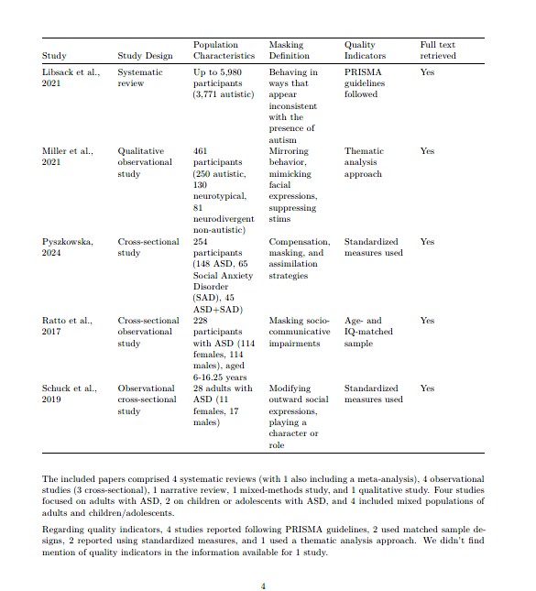
Works Referenced - Honourable Mentions
Notes:
See report by Elicit AI on Masking in ASD. References #1, 13, 20, 21, 22, 23, 24, 25, 26, and 27 are listed here. I do not find study #1 or 21 to be sound, but the other 8 seem at least moderately appropriate.
Elicit AI pulled up to 50 resources on the topic. However, less than 10 studies meet sound criteria. These studies are from 2017-2024.
There was 1 meta-analysis (source #22), 3 systematic reviews (source #20, 1, and 24), 4 observational studies (3 cross-sectional) (sources #13, 25, 26, and 27), 1 mixed methods (source # 23), and 1 narrative study (source #21).
Only studies #26, 23, and 20 used children - 2 being sound studies (#26 and #20). #22, #24, #13, and #25 had mixed populations with some children included.
#20, #22, #24, #13, #25, and #26 have okay population characteristics ranging from 254 to 16,066 participants. Only #20, #22, and #24 are in the thousands (#20 was with kids).

Slide 27
Thank
You for masking!

