Slide 1


Taking
Data
Effectively
Kourtney Gorham, R.Psych #1189 (she/her) gorham.kourtney@prairiesouth.ca
Prince Arthur School
March 5th, 2025
Notes:
Today we will be discussing taking data effectively.
You may notice the Star Trek character, Data, who not only shares the name ‘Data’ but also the expression that most people make when hearing the word.
My name is Kourtney. I’m a registered psychologist and work as an Advocacy and Behaviour Support Consultant in our division. And I’ll try to make this as painless as possible.

Slide 2
“If you can measure a behaviour as part of the problem, you can shape it as part of the solution.”
- PSSD Behaviour Learning Cycle (BLC)
Notes:
I do recommend the Behaviour Learning Cycle professional development for anyone who wants an in-depth explanation of data and how it relates to creating function-based, Positive Behaviour Support Plans. The above quote is from that PD - which you can sign up for on the Learning Opportunities Site.
You all know that data is all around us - quantitatively (or with numbers) we track student’s attendance, our speed when driving, our weight on a scale, our job performance on rubrics, the temperature, etc. We ask our friends for qualitative data (or their words) about whether the movie or restaurant were worth it.
There are many reasons to take data, but for our purpose at school I want to focus on my two favorite reasons:

Slide 3
The Why of Taking Data
Meet the needs of our students:
Meet our own needs:
Determine behaviour functions and missing skills.
Ensure consistency among team members.
Track and celebrate student growth.
See the effectiveness of our interventions.
Communicate effectively and respectfully with caregivers and other team members.
Notes:
Taking data, and doing it well, allows us to support children in ways we couldn’t otherwise. It allows us to pinpoint the function of their behaviour, their missing skills, and allows for consistency among team members.
I just worked with a boy in Laurie’s class with an SLD diagnosis and progress was slow going. This was making team members feel a bit defeated or sad for this kid who was working so hard. But, I got to come and take data on his learning which objectively proved that the work that Laurie, Bethany, and Darla are doing every day is making a difference - he was making improvements, albeit in his own way and at his own pace!
Which leads into my favourite part about taking data - it benefits you!
We get to see the effectiveness of our teaching!
And best of all, if you want to get your way, nothing is more effective than an objective number. It’s pretty hard to fight facts.
I’m going to focus on this concept on the next two slides.

Slide 4
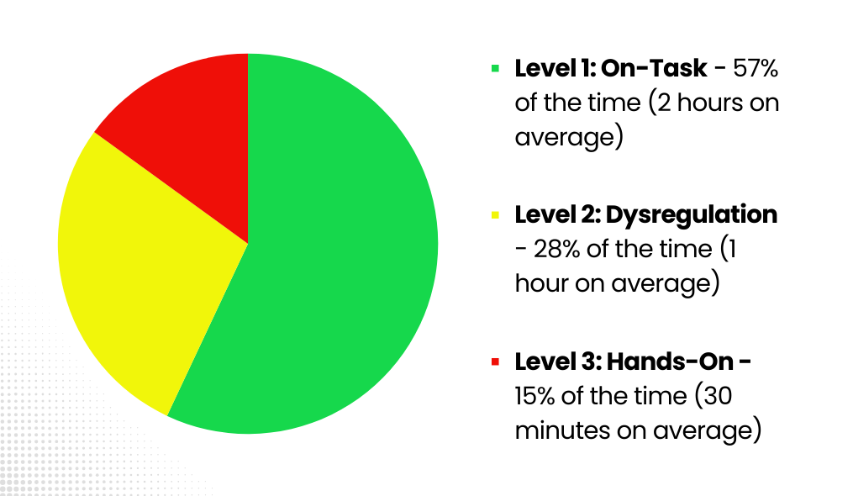
Caregiver Meeting Example
Notes:
Here’s what I mean:
This is a real example of data I took on a student in your building. (If you know who, just pretend you don’t and let’s not say the name aloud because I de-identified it on purpose).
The caregiver and outside agencies were requesting full days but the school was noticing in our day-to-day reality that the student was not ready for that.
We could have just discussed this anecdotally (or qualitatively) at the meeting - but that leaves a lot of room to discuss, debate, etc.
Instead, I used Class Dojo to create a visual graph (which is great for communicating with families who are EAL or would benefit from less written information). It objectively showed how the past month at school had been:
2 hours or 57% of the time on-task and 1.5 hours of off-task, dysregulated behaviour (43% of the time)
We also didn’t have to get into the emotional and hard-to-hear details of each incident that occured. The percentages and times were clear on their own.
The student was not ready for an increase despite our hopes and dreams, so we ended that meeting without increasing the time.
It is really hard to argue with facts.

Slide 5

Staff
Meeting Example
Step 1: Tally the student’s behaviour of saying “no.”
Step 2: When the student says “no,” put the tally under the antecedent:
Adult conversation
Prompting the student
Unknown
110x
132x
Guess whose behaviour was “worse?”
Notes:
I think a lot of people see data as an additional chore on top of our mountain of responsibilities, but I’ve always seen it as a way to communicate effectively and respectfully.
Here is a staff example:
I had been training staff on a behaviour plan for a student in this building (again, if you know who, don’t say the name).
To be honest, everyone wasn’t getting what I was throwing down. I felt at times my modeling was ineffective.
So what could I do that would not be offensive to the hardworking members of the team? Change my approach to numbers!
First, I tallied the student’s behaviour of saying “no.”
Then, I looked at the antecedents that occurred before the student’s behaviour of saying “no.” These were a) adult comments, b) prompting the student, and c) unknown. Again, it was a simple tally under a), b), or c).
In just two half an hour sessions of frantic tallying, I found out that the student said “no” 54-56x (or 108-112x per hour on average).
But, then I got to shift away from focusing on the student to what we - including myself - were doing to exacerbate the problem.
We had made a) 26 unnecessary adult comments and b) 40 prompts in a half an hour for a total of 66 verbal comments/commands! (That’s 132 comments from us in an hour, if you’re wondering)!
Now, 33% of the time the student said “no” for an unknown reason. But, that meant we could prevent up to 67% of the times that the student said “no” because our comments were the trigger!
I was also able to anecdotally (qualitative data) note that the student had a more visceral reaction to our unnecessary chit-chat vs. our direct prompts.
Did this data solve everything the next day? No, of course not. But it allowed for a non-judgemental framework to discuss more wait time and purposeful communication and it shifted the focus from the student’s behaviours to our role in those behaviours.
Am I part of the data sample? Of course. I am open to people taking data on my role in student behaviours and when it occurs, I only get better in my approach!
Note: This was 2 half-an-hour data taking times - you don’t need to take data every day for hours upon hours to get the information you need. You and the team will know if the data sample was representative of the day-to-day experience.

Slide 6


When you bring objective data to crucial conversations.
When they tell you the staff meeting will be about data.
Notes:
Now, if I haven’t taken you from this Data to this Data, well… some eggs are harder to crack.
But, you could call my husband and ask what it’s like arguing with me - not easy. I bring the facts aka data.
And you too can bring hard facts aka objective data to crucial conversations. I promise it helps and you will sleep well at night.

Slide 7



Roadmap to Taking Data
← Behaviour can be
→
Episodic
High Rate
Discrete
By Opportunity
Notes:
Now, maybe you’re completely convinced that data is the best tool around.
Your barrier might be the how of taking data or where to start.
Behaviour is either:
Episodic - like a meltdown with a clear stop/end time
High Rate - occurs frequently like blurting, a stim, or the saying “no” example
Discrete - brief, hard-to-notice behaviours like picking one’s own skin or spitting
By Opportunity - occurring after a request like “get out your math sheet” or attendance
If the behaviour is episodic - use an ABC form to determine frequency, severity, and duration of the behaviours.
If the behaviour is high rate or discrete - use an interval/tally data form to determine the frequency and latency of the behaviours.
If the behaviour is by opportunity - use a by opportunity form to determine frequency, severity, and latency/ratio.

Slide 8

Data Tells Us…
← Behaviour can be measured via
→
Severity
Frequency
Duration
Latency
Notes:
The entire point of data is to figure out the:
Severity - the intensity of the behaviour.
Frequency - how often the behaviour occurs.
Duration - how long the behaviour lasts.
Latency - the time between the request/event and the student follow through.
We do not need to take longitudinal data to figure this out - a couple instances is enough in most cases as you and the team will know if your data samples are representative of the day-to-day experience. I never tell the caregivers, I took data twice on this behaviour because we are taking anecdotal (qualitative) data each and every day. It is part of trusting your team. I also, always represent the data as averages not an absolute.

Slide 9

Step-by-
Step Support
Notes:
You will be getting a package today that walks through each of the ways to take data with step-by-step instructions of how to calculate that data and for which purpose - i.e duration or frequency, etc.
There are also step-by-step instructions of how to create data forms on Google Forms, in Class Dojo, and by finding ready-made data forms on Connect.

Slide 10
"Some is not a number. Soon is not a time. Hope is not a plan.“
- Dep. Minister Dan Florizone
Notes:
Thanks for listening today and feel free to email me if you have any questions.

